Slide 1
Results Summary PPT Template Instructions
This summary PPT template will help you present your results from the Diabetes Prevention Impact Toolkit in a graphic, easy-to-understand way.
The PPT file contains two slide decks—one to use with the Employer or Insurer module, and one to use with the State module. Use the deck you need, and delete the rest.
Follow the instructions in the notes for each slide to replace the green Xs with your data (be sure to click Show Data Table under each figure in the Results Dashboard to see all relevant data).
Change slide formatting as needed to match your organization’s branding.

Slide 2
Diabetes Prevention
Impact Toolkit
RESULTS SUMMARY–
[insert Employer or Insurer Name]
Notes:
[Enter your employer or insurer name where indicated]

Slide 3
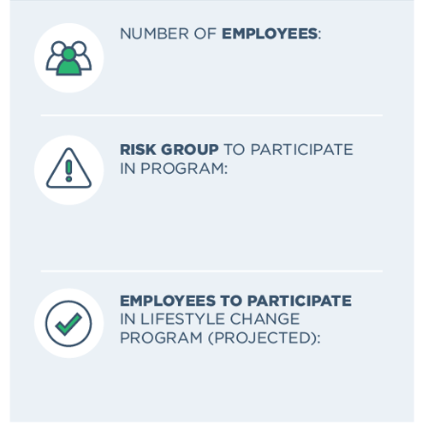
Your Demographics
X,XXX
XXXXXXXX XXXXXXX XXXXXX
XXX
Notes:
[These are the demographics of the covered population you selected.
For Number of Employees: Enter the total number of employees from the Projected Participants table on the Results Dashboard.
For Risk Group: Enter the group chosen, found in the Selected Input panel of the Results Dashboard.
For Employees to Participate: Enter # to Participate in Intervention from Projected Participants table.]

Slide 4
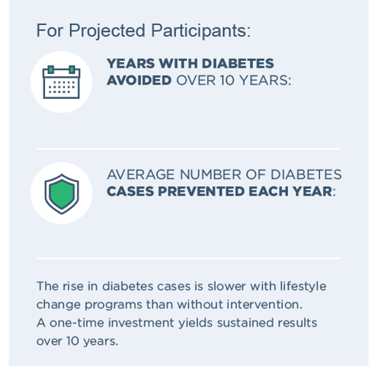
Cumulative Cases of Diabetes
XX
XX
Notes:
[For Years with Diabetes Avoided: Enter # from Year 10 in Years with Diabetes Averted column on Cumulative Cases of Diabetes and Years with Diabetes Averted table on Results Dashboard.
For Cases Prevented Each Year: Divide the Years with Diabetes Averted in Year 10 by 10 to get the average number of diabetes cases prevented each year.]

Slide 5
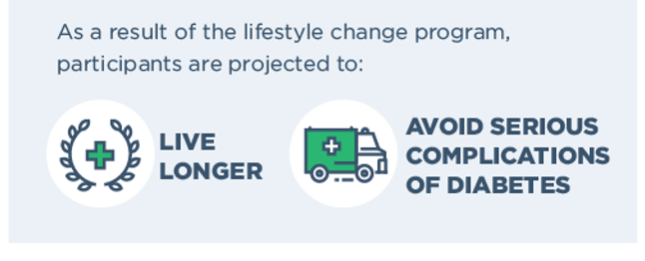
Cumulative Years of Life Gained

Slide 6
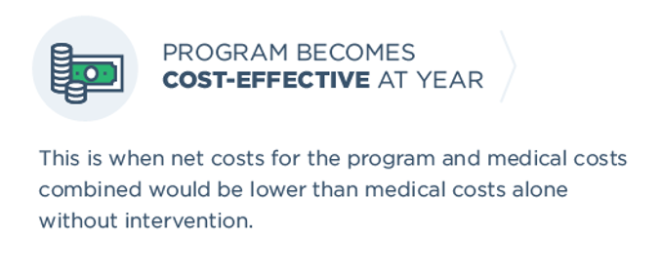
Costs & Savings:
Net Cost per Participant
X
Notes:
[Enter the year at which the Net Cost becomes a negative number in the Net Costs table on the Results Dashboard.]

Slide 7
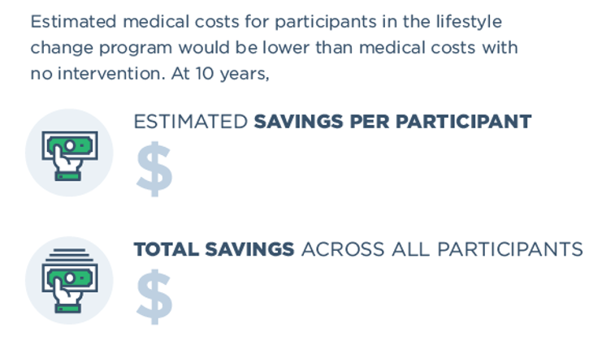
Costs & Savings: Cumulative Medical Costs per Participant
XXX
XX,XXX
Notes:
[For Savings per Participant: Enter the 10-year Medical Cost Savings from the Cumulative Medical Costs table.
For the Total Savings: Multiple Medical Cost Savings in Year 10 by the number of participants to get the total savings across participants.]

Slide 8
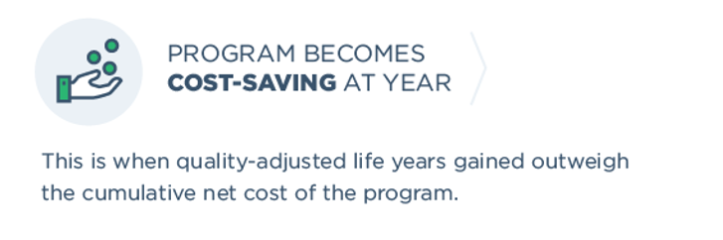
Costs & Savings: Incremental Cost-Effectiveness Ration (ICER)
X
Notes:
[Enter the year at which the ICER column reads “cost saving” in the ICER table on the Results Dashboard.]

Slide 9
Diabetes Prevention
Impact Toolkit
RESULTS SUMMARY –
[insert State Name]
Notes:
[Enter your state name where indicated]

Slide 10
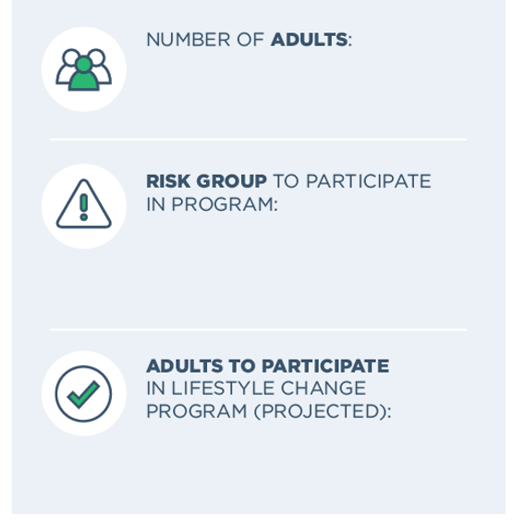
Your Demographics
XXX,XXX
XXXXXXXX XXXXXXX XXXXXX
X,XXX
Notes:
[These are the demographics of the covered population you selected.
For Number of Adults: Enter the total number of adults from the Projected Participants table on the Results Dashboard.
For Risk Group: Enter the group chosen, found in the Selected Input panel of the Results Dashboard.
For Adults to Participate: Enter # to Participate in Intervention from Projected Participants table.]

Slide 11
Cumulative Cases of Diabetes
XX
XX
Notes:
[For Years with Diabetes Avoided: Enter # from Year 10 in Years with Diabetes Averted column on Cumulative Cases of Diabetes and Years with Diabetes Averted table on Results Dashboard.
For Cases Prevented Each Year: Divide the Years with Diabetes Averted in Year 10 by 10 to get the average number of diabetes cases prevented each year.]

Slide 12
Cumulative Years of Life Gained

Slide 13
Costs & Savings:
Net Cost per Participant
X
Notes:
[Enter the year at which the Net Cost becomes a negative number in the Net Costs table on the Results Dashboard.]

Slide 14
Costs & Savings: Cumulative Medical Costs per Participant
XXX
XX,XXX
Notes:
[For Savings per Participant: Enter the 10-year Medical Cost Savings from the Cumulative Medical Costs table.
For the Total Savings: Multiple Medical Cost Savings in Year 10 by the number of participants to get the total savings across participants.]

Slide 15
Costs & Savings: Incremental Cost-Effectiveness Ration (ICER)
X
Notes:
[Enter the year at which the ICER column reads “cost saving” in the ICER table on the Results Dashboard.]

