Slide 1
MILESTONES MATTER: UNDERSTANDING YOUR CHILD’S DEVELOPMENT
An
[Enter presenters' information here]

Slide 2
What You Will Learn
Demonstrate why monitoring milestones are important in identifying common developmental concerns
Learn about the different areas of developmental milestones that children reach at different ages
Know what steps to take if there is ever a concern about your child’s development
Learn about free tools and resources to help monitor your child’s development including how to communicate concerns with teachers, healthcare providers, and others
[If applicable: Learn about state/local resources]

Slide 3

Why Monitor Your Child’s Development?
Developmental disabilities are common and often not identified before school age
1 in 6 children (3–17 years of age) has a developmental disability¹
Developmental disabilities are even more common among children from low-income households, with 1 in 5 children experiencing a developmental disability¹
    Zablotsky, B, et al, Pediatrics 2019

Slide 4
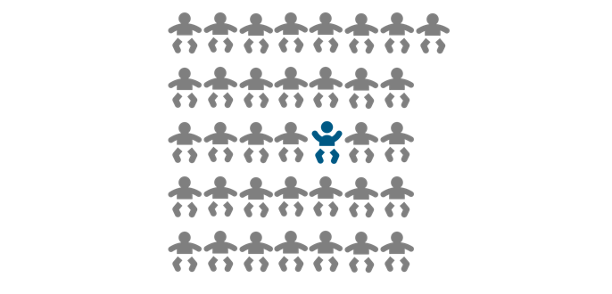
Why Monitor Your Child’s Development?
About 1 in 36 children is estimated to have autism spectrum disorder (ASD)¹
    Maenner, MJ, et al. CDC, MMWR Surveillance Summary 03/2023

Slide 5
UNDERSTANDING DEVELOPMENTAL MILESTONES

Slide 6

What Are Developmental Milestones?
Things most children can do by a certain age like:
  By 2 months: reacting to loud sounds
  By 9 months: lifting arms up to be picked up
  By 3 years: drawing a circle, when you show them how
Children reach milestones in how they play, learn, speak, act, and move
Though all children develop at their own pace, most children reach developmental milestones at or around the same age
Notes:
.

Slide 7
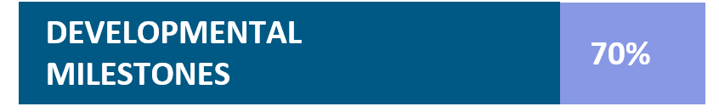
Why Monitor Developmental Milestones?
Monitoring developmental milestones enables parents to support their child’s growth and act early if there is a concern.
In a recent survey, parents frequently searched for information about developmental milestones.
When 1,002 parents were asked about child-rearing topics they seek information about, 70% reported seeking information about developmental milestones, which was the highest score among topics.
⁵Zero to Three survey, 2018

Slide 8

Domains (Areas) of Development
Social/Emotional
Language/Communication
Cognitive (learning, thinking, problem-solving)
Movement/Physical
Notes:
Child developmental milestones are divided into four main areas which are commonly referred to as domains. The four domains or areas of developmental milestones are:
-Social/Emotional (example: at 2-months looks at your face, at 2-years notices when others are hurt or upset, like pausing or looking sad when someone is crying)
-Language/Communication (example: at 4-months makes sounds like “oooo”, “aahhh” (cooing), at 4-years says sentences with four or more words
-Cognitive (example: at 6-months puts things in their mouth to explore them, at 5 years counts to 10
-Movement/Physical (example: at 15-months takes a few steps on their own, at 30-months jumps off the ground with both feet)

Slide 9
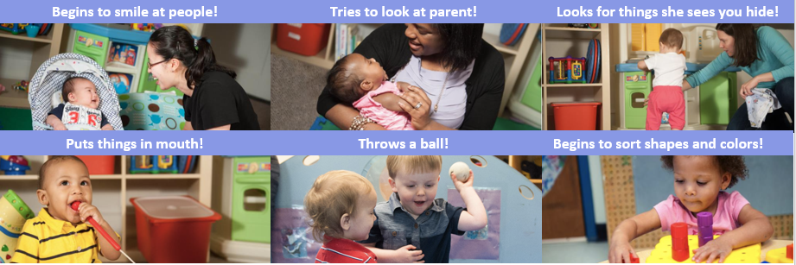
So Many Milestones to Celebrate!
Monitoring milestones helps every parent and caregiver support their child’s development
CDC’s Learn the Signs. Act Early. Milestones in Action Photo and Video Library
shows what each milestone looks like in real-life situations
Notes:
Milestones in Action Photo and Video Library: https://www.cdc.gov/ncbddd/actearly/milestones/milestones-in-action.html

Slide 10
CDC’S FREE TOOLS CAN HELP YOU

Slide 11
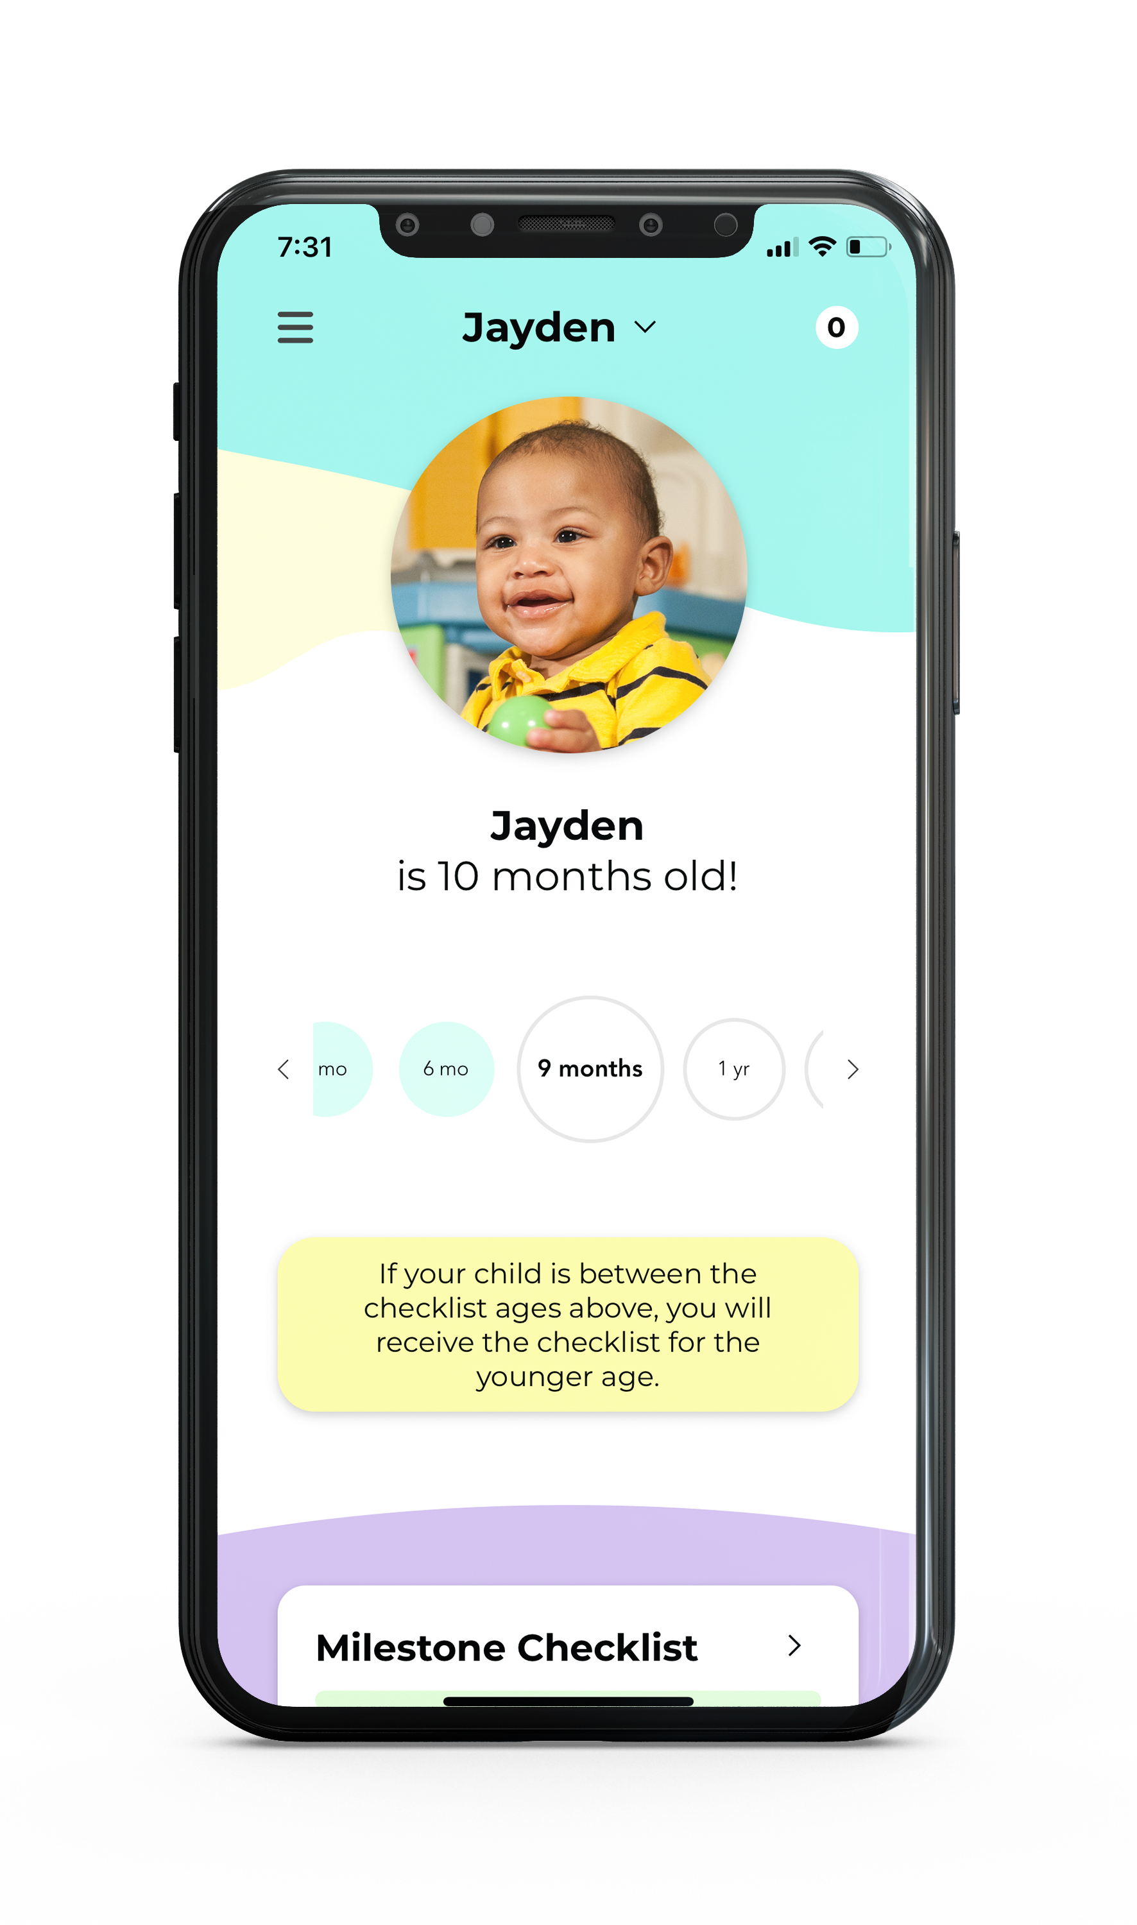
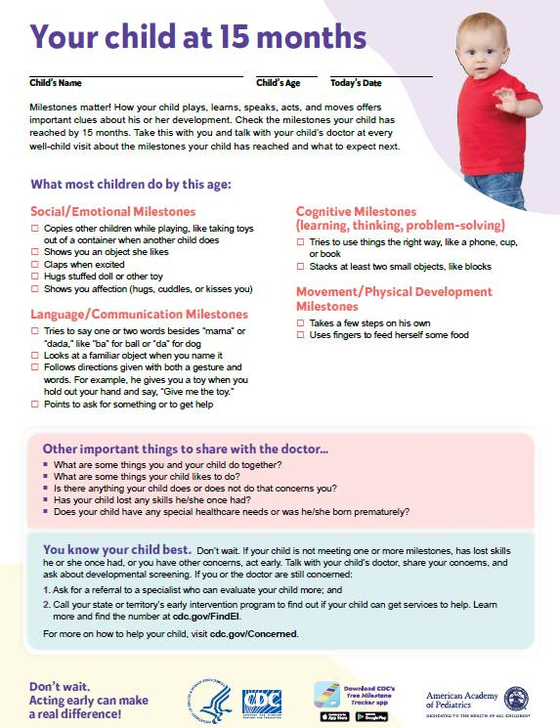
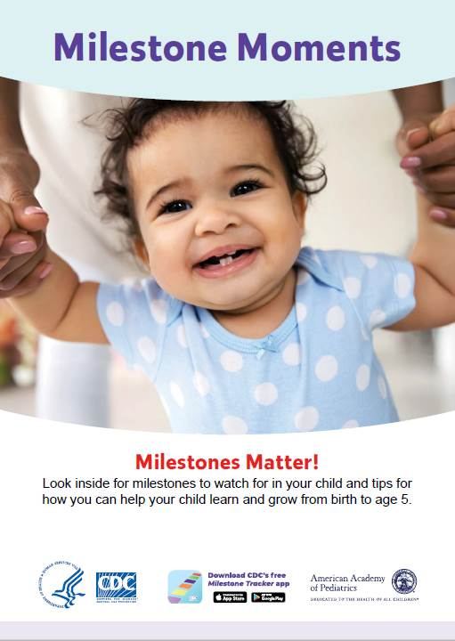
CDC’s Milestone Materials
Free Tools for Monitoring Children’s Development
www.cdc.gov/ActEarly/Materials
Notes:
CDC’s milestone checklists and other materials including but not limited to CDC Milestone Tracker App and milestone moment booklets are great tools for tracking your child’s development
All materials have been updated to reflect the updated milestones released in 2022
The LTSAE materials also includes age-specific parenting tips that can help you navigate parenting life at each age and stage of your child’s growth

Slide 12
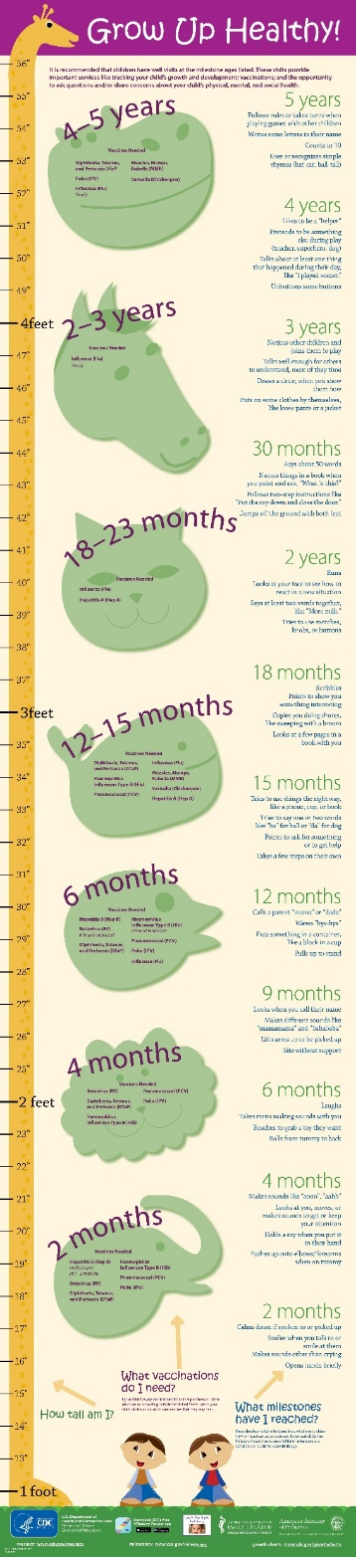
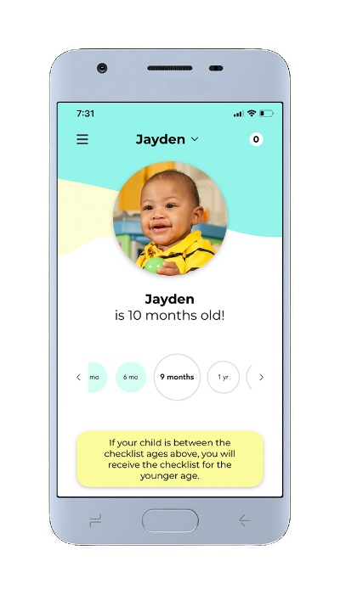
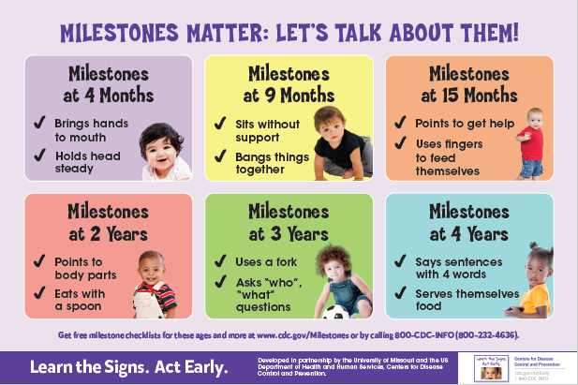
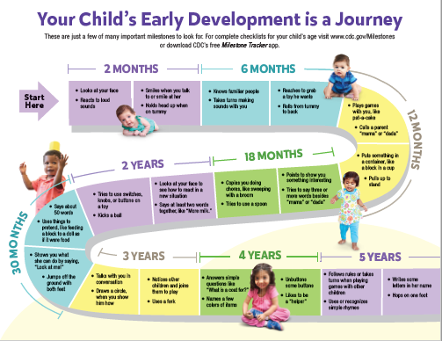
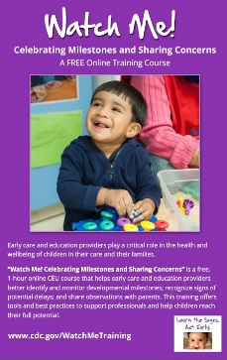

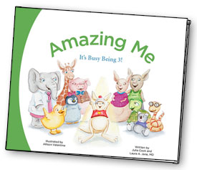

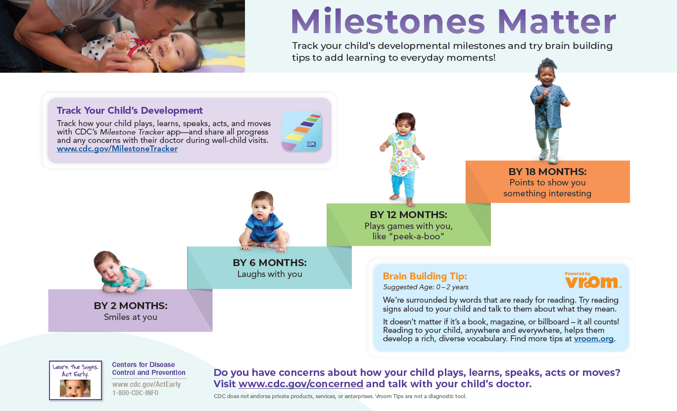
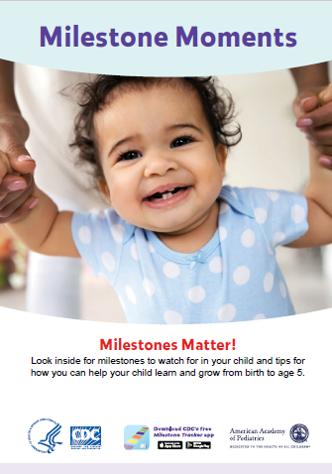
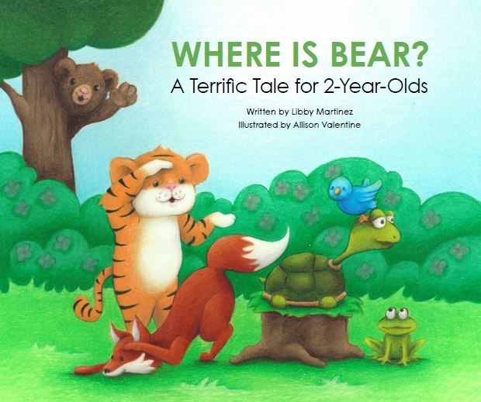
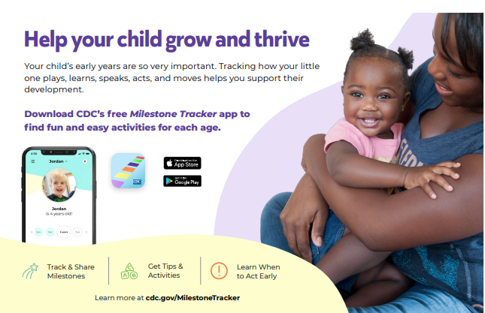
www.cdc.gov/actearly
Notes:
Here is a visual example of some of the FREE materials the Learn the Signs. Act Early. program offers to support parents in tracking their child’s milestones.
All of these are available at www.cdc.gov/actearly

Slide 13
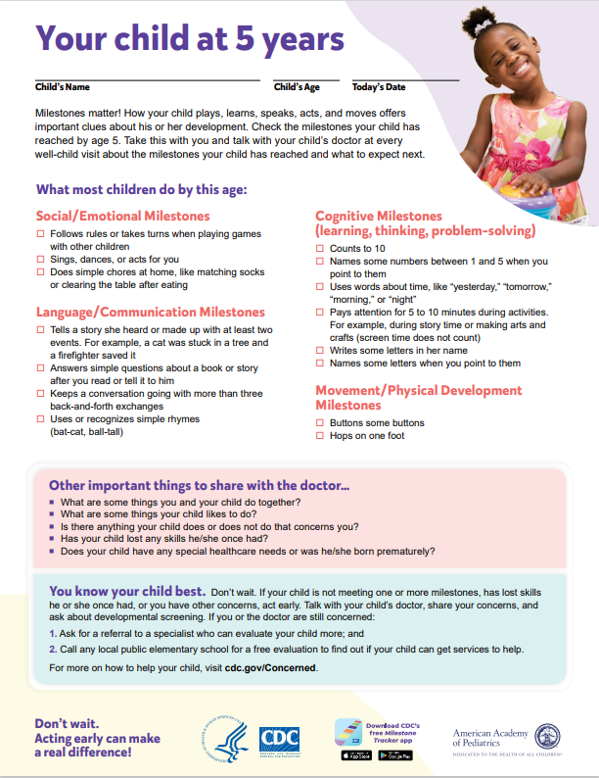
Milestone Checklists
Free, printable checklists are available online (and in the Milestone Tracker app) featuring
Developmental milestones by domain/area of development
  Guidance on what to expect for most children by the next age checklist (up to age 5 years)
Open-ended questions for you to answer
Parenting tips and activities to help your child learn and grow
Guidance for what to do if you have a developmental concern
Early intervention information
Reminders about well visits and developmental screening
Notes:
Here are some of the additional checklist features included in the 2022 milestone checklist revisions
Checklists are family-friendly and designed to be used by parents/caregivers, but may be used by or discussed with parents/caregivers by a variety of early childhood professionals, including the primary care clinician who can discuss at the health supervision visits (with which the checklists coincide).
REMEMEBER: developmental screening is different than using the milestone checklists. They work together and are both important! The checklists will remind you when your child needs developmental screening.

Slide 14
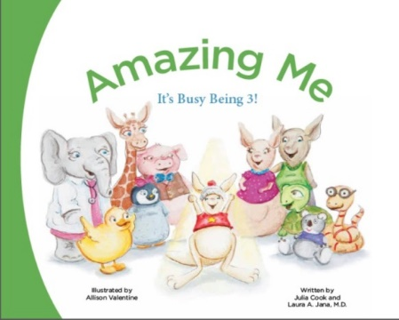
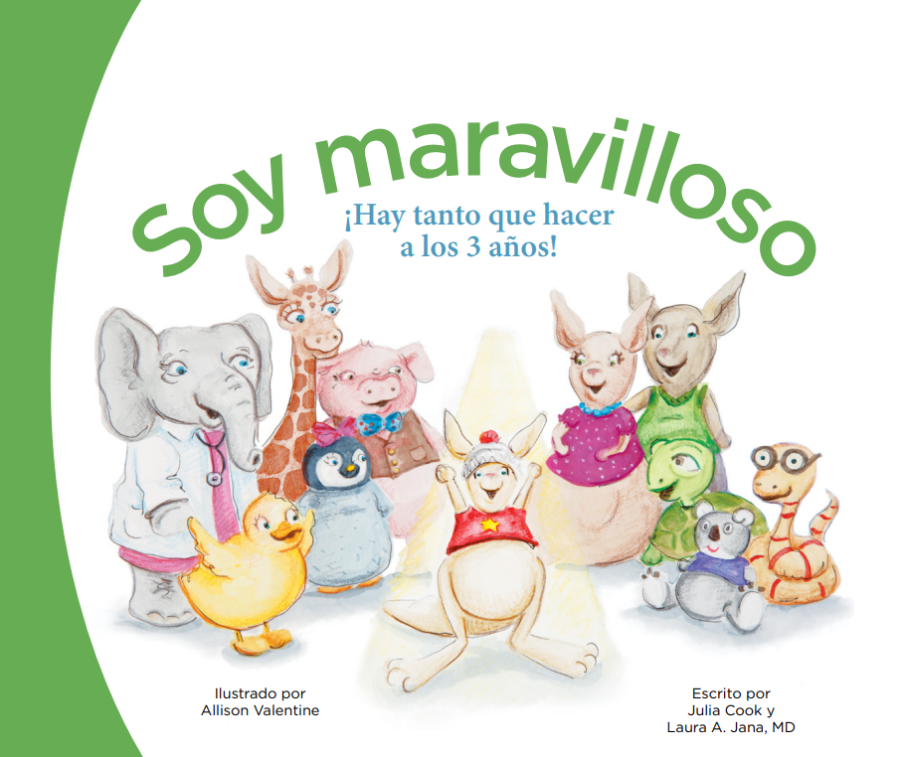
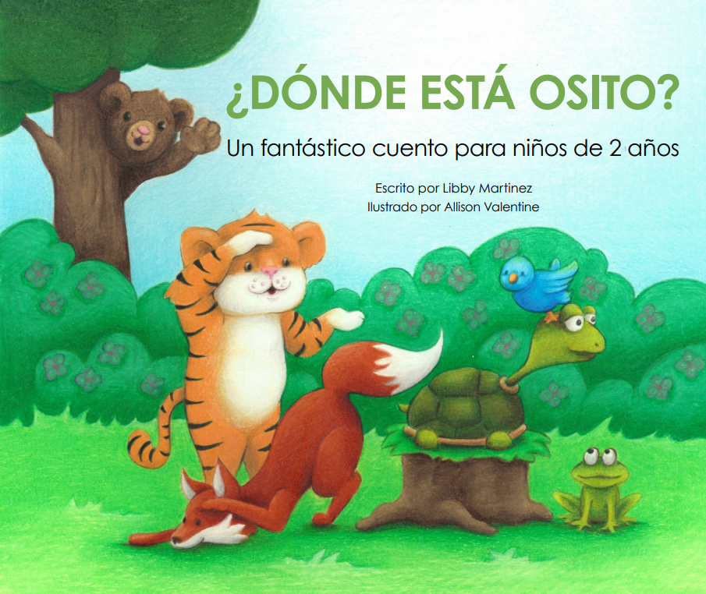


Amazing Children’s Books
Milestones highlighted throughout story
Parent tips and information about when to act early on concerns
Available in English and Spanish
Order free books: https://www.cdc.gov/ActEarly/Orders
Notes:
LTSAE has three amazing books available in English and Spanish that highlight age specific milestones and parenting tips.
1 year old book: Babys Busy Day/Un dia ocupado del bebe
2 year old book: Where is Bear/Done Esta Osito
3 year old book: Amazing Me/Soy Maravilloso
-These book ship anywhere in the U.S. for free

Slide 15

All Materials are Relatable and Accessible
Written in family-friendly language
Includes milestones easy to see in your child
Milestones were tested for understanding with families from diverse backgrounds
Available in multiple languages and in a variety of formats (paper, online, and app)
Notes:
Cognitive testing of the milestones was done with families
From different U.S. regions
With different levels of education
With various income levels

Slide 16
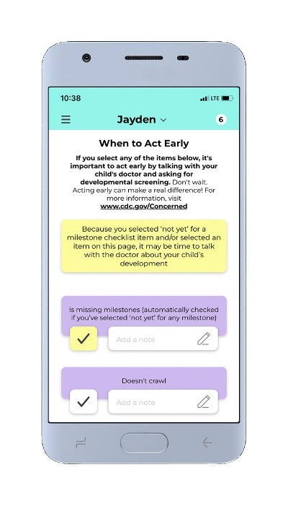
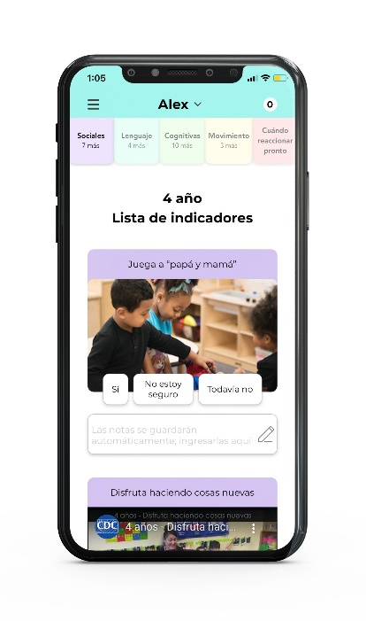
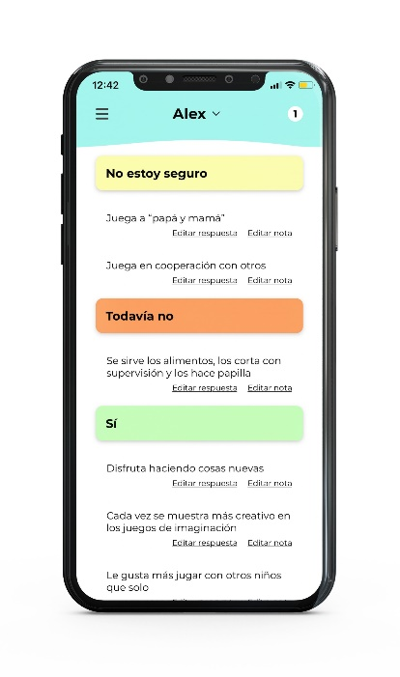
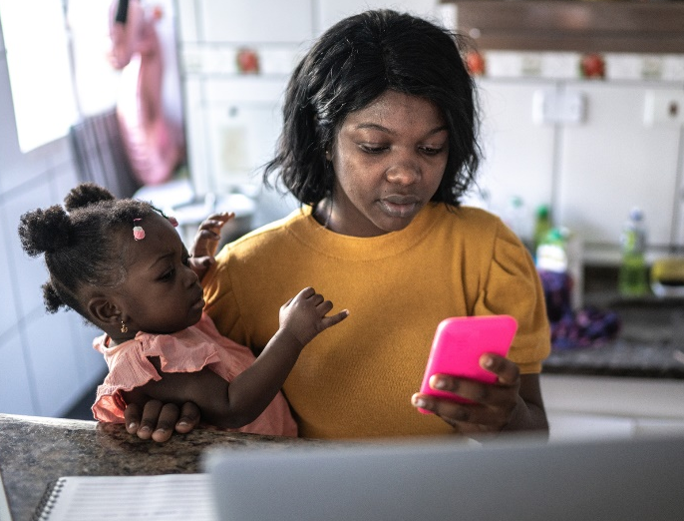
CDC’s Milestone Tracker App
Includes the same content as the milestone checklists
Available in English and Spanish
Available for iOS and Android phones
Interactive milestone checklists show each milestone with a photo or video
FREE with no ads
Easy to use
Milestones in Action photos and videos show you what each milestone looks like
Available at: www.cdc.gov/MilestoneTracker
Available at: www.cdc.gov/Sigamos

Slide 17
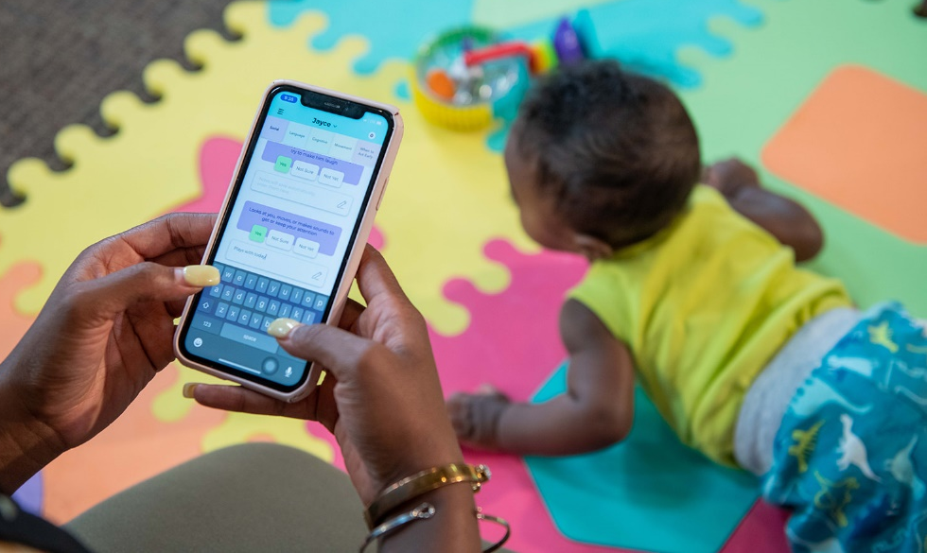
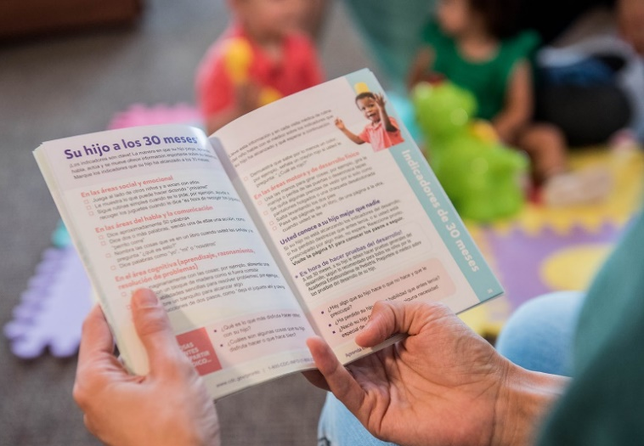
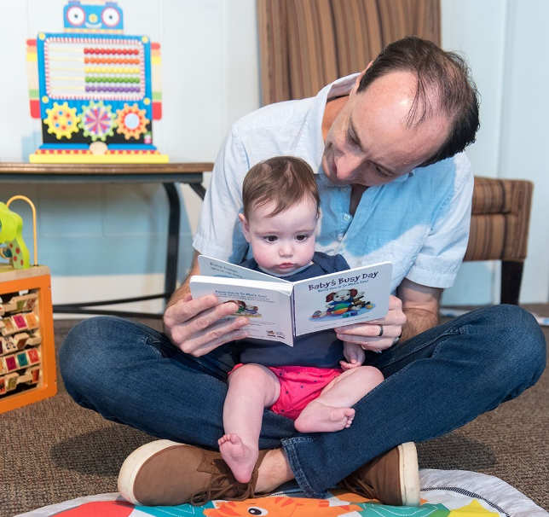
Start Monitoring Your Child’s Development Today!
Download CDC’s Milestone Tracker app
Order a Milestone Moment booklet
Order children’s books
Complete an online milestone checklist
Visit cdc.gov/ActEarly for resources and information

Slide 18
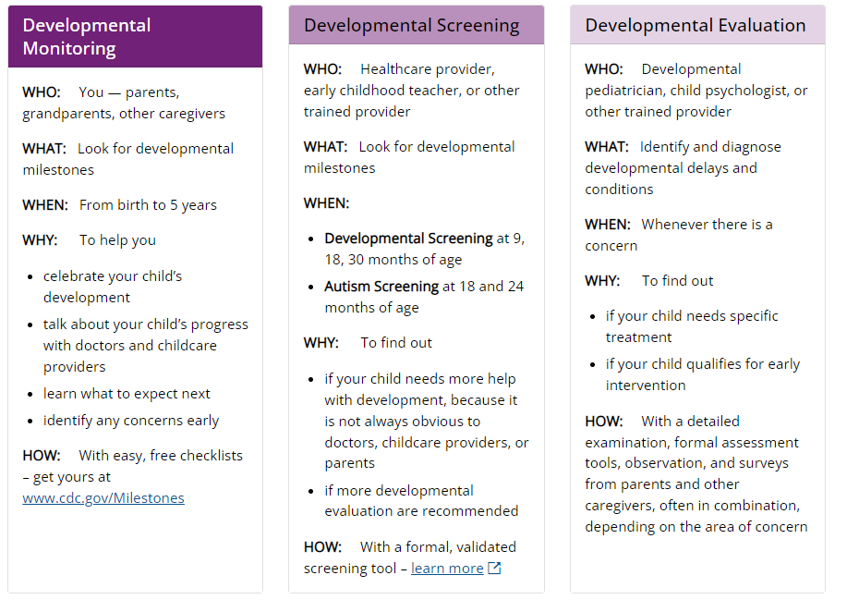
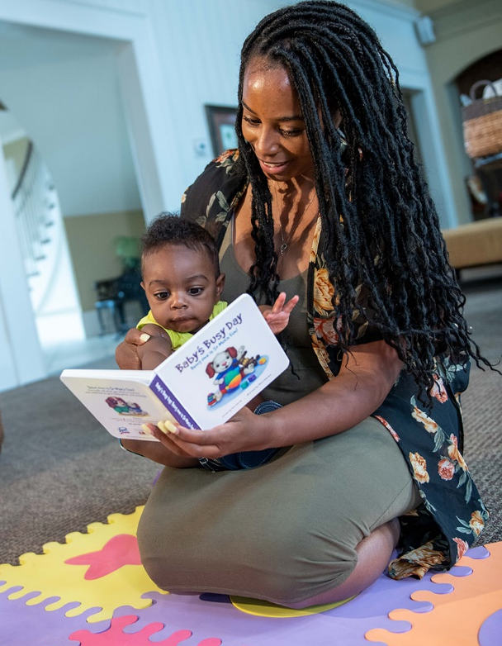
Developmental Monitoring, Screening, and Evaluation…
What is the Difference?
Learn the Signs. Act Early. materials are for DEVELOPMENTAL MONITORING
Notes:
Now that you know what developmental milestones are and how to monitor your child’s development let’s review the difference between developmental monitoring, screening, and evaluation.
Developmental Monitoring: Developmental monitoring observes how your child grows and changes over time and whether your child meets the typical developmental milestones in playing, learning, speaking, behaving, and moving. Parents, grandparents, early childhood providers, and other caregivers can participate in developmental monitoring.
Developmental Screening: Developmental screening takes a closer look at how your child is developing. Your child will get a brief test, or you will complete a questionnaire about your child. The tools used for developmental and behavioral screening are formal questionnaires or checklists based on research that ask questions about a child’s development, including language, movement, thinking, behavior, and emotions. Developmental screening can be done by a doctor or nurse, but also by other professionals in healthcare, early childhood education, community, or school settings. Developmental screening is typically done by the child’s healthcare provider, early childhood teacher or other trained provider.
Developmental Evaluation: A brief test using a screening tool does not provide a diagnosis, but it indicates if a child is on the right development track or if a specialist should take a closer look. If the screening tool identifies an area of concern, a formal developmental evaluation may be needed. This formal evaluation is a more in-depth look at a child’s development, usually done by a trained specialist, such as a developmental pediatrician, child psychologist, speech-language pathologist, occupational therapist, physical therapist, or other specialist. The specialist may observe the child, give the child a structured test, ask the parents or caregivers questions, or ask them to fill out questionnaires. The results of this formal evaluation determines whether a child needs special treatments or early intervention services or both. Developmental evaluation is typically done by a developmental pediatrician, child psychologist, or other trained provider.
Learn more: https://www.cdc.gov/ncbddd/childdevelopment/screening.html

Slide 19
WHAT TO DO IF YOU HAVE CONCERNS

Slide 20

How to Get Help For Your Child
If your child is not meeting a milestones for their age or you have ANY concerns:
Don’t wait; acting early can make a real difference
Make an appointment with your child’s healthcare provider
Complete a milestone checklist
  Write down your questions and concerns; take them with you to the doctor’s appointment
Ask your child’s doctor about developmental screening
*If you or the doctor thinks there might be a delay, ask the doctor for a referral to a specialist
who can do more evaluation.
Notes:
Parents and others may complete a milestone checklist, such as those available from the CDC’s LTSAE program we are talking about today. These checklists are an important resource to help parents understand what to look for and when a child may be missing a milestone. Because all milestones on the CDC checklists are those that most children usually do by the listed age, it is important to talk with your doctor or health care professional about any missed milestones.
“Developmental Screening” is similar to what is done with a milestone's checklist by a parent but is different as it usually happens at a healthcare providers office or similar setting where a questionnaire or other tool is used to help decide whether a child is at risk for a developmental delay. These formal screening tools are recommended at least at specific well-child health visits in early childhood. Be sure you ask your doctor or clinic about developmental screening! The CDC LTSAE milestone checklists will remind you when formal screening is due.

Slide 21

Early Intervention is Best
The earlier a child is identified as having a developmental disability or delay, the sooner interventions and family supports can start
    While earlier is better, it is never too late to start services and get support
Early intervention can improve your child’s skills, abilities, future school performance, and long-term self-care
Early identification and intervention help families understand their child’s strengths as well as areas in which they may need support
Getting services for developmental delays early can help prevent challenging behaviors later

Slide 22
What Else Can I Do?
You can also connect with your state or territory’s early intervention program to find out if your child can get services to help. A doctor’s referral may not be necessary.
If your child is under age 3:
  Call your state or territory’s early intervention program and say: “I have concerns about my child’s development, and I would like to have my child evaluated to find out if they are eligible for early intervention services.”
If your child is 3 years old or older:
  Call the local public elementary school, ask to speak with the person in charge of special education, and say: “I have concerns about my child’s development and would like to have my child evaluated through the school system
  for preschool special education services.”
Notes:
You can find your state or territories early intervention contact by visiting: https://www.cdc.gov/ncbddd/actearly/parents/states.html

Slide 23

CDC’s Act Early Ambassadors
Represent 48 states; Washington, DC; and 3 territories
Champion CDC’s Learn the Signs. Act Early. program
Are passionate about child development and early identification
Work to add developmental monitoring into programs across their state/territory
Connect with your ambassador here: cdc.gov/ActEarly/Ambassadors
Notes:
You are welcome to reach out to your Act Early Ambassador

Slide 24
QUESTIONS?

Slide 25

Contact Us!
[Enter presenters contact information here]
CDC’s Act Early Inbox
  ActEarly@cdc.gov

