Slide 1




Slide 2
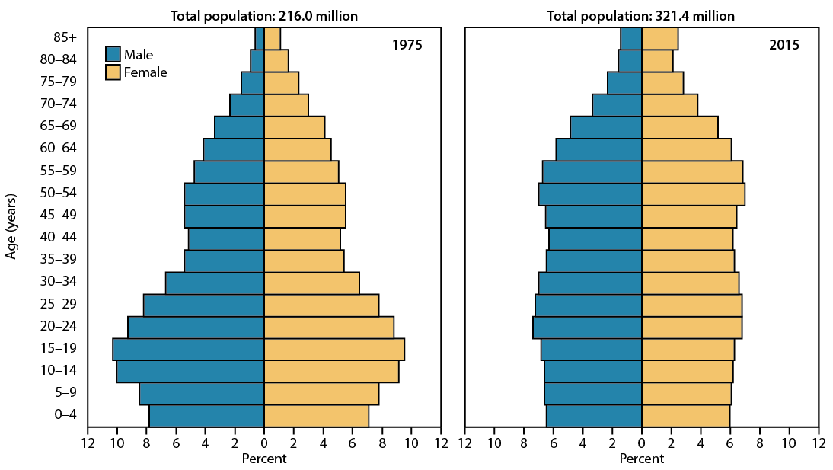
Population, by sex and age
NOTE: Resident population.
SOURCE: NCHS, Health, United States, 2016, Figure 1. Data from the U.S. Census Bureau 1975 intercensal estimates of the July 1, 1975 resident population; 2015 postcensal estimates of the July 1, 2015 resident population.

Slide 3
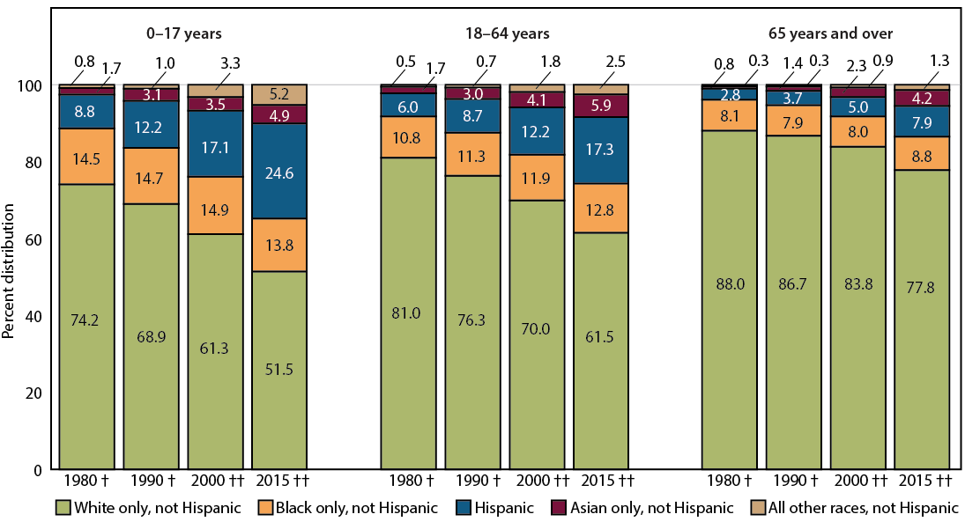
Population, by race and Hispanic origin, and age
NOTES: Resident population. Persons of Hispanic origin may be of any race. Race data for 2000 and 2015 are not directly comparable with data from 1980 and 1990 because of the use of different Standards for classifying race.
SOURCE: NCHS, Health, United States, 2016, Figure 2. Data from the U.S. Census Bureau decennial estimates 1980, 1990, and 2000; postcensal estimate 2015.

Slide 4
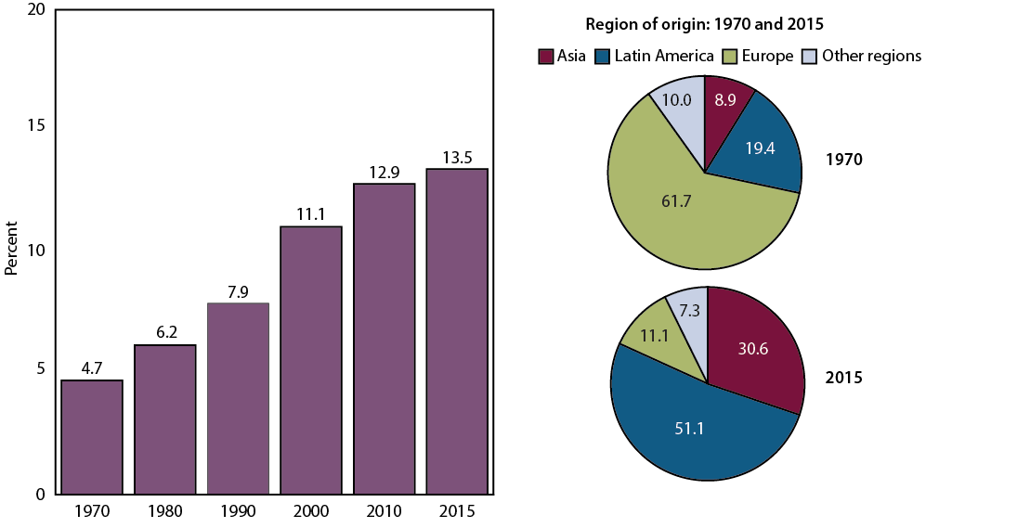
Foreign-born population
NOTES: Resident population for 1970–2000 and civilian noninstitutionalized population for 2010 and 2015. The foreign-born population includes anyone who is not a U.S. citizen at birth among those with region of birth reported.
SOURCE: NCHS, Health, United States, 2016, Figure 3. Data from the U.S. Census Bureau, Decennial Census 1970–2000; American Community Survey (ACS) 2010 and 2015.

Slide 5
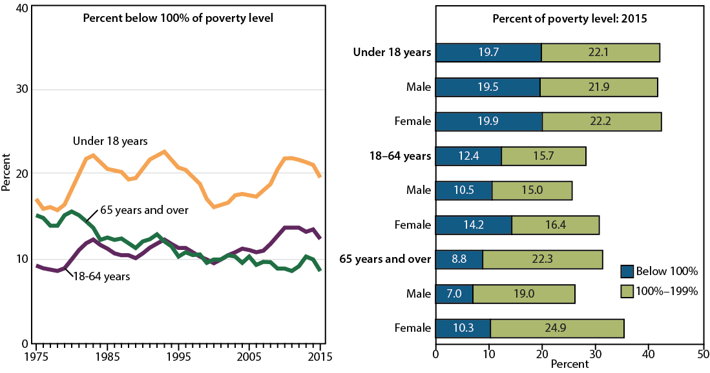
Population, by percent of poverty level and age
NOTES: Civilian noninstitutionalized population (all persons). Percent of poverty level is based on family income and family size and composition using U.S. Census Bureau poverty thresholds.
SOURCE: NCHS, Health, United States, 2016, Figure 4. Data from the U.S Census Bureau, Current Population Survey, Annual Social and Economic Supplements.

Slide 6
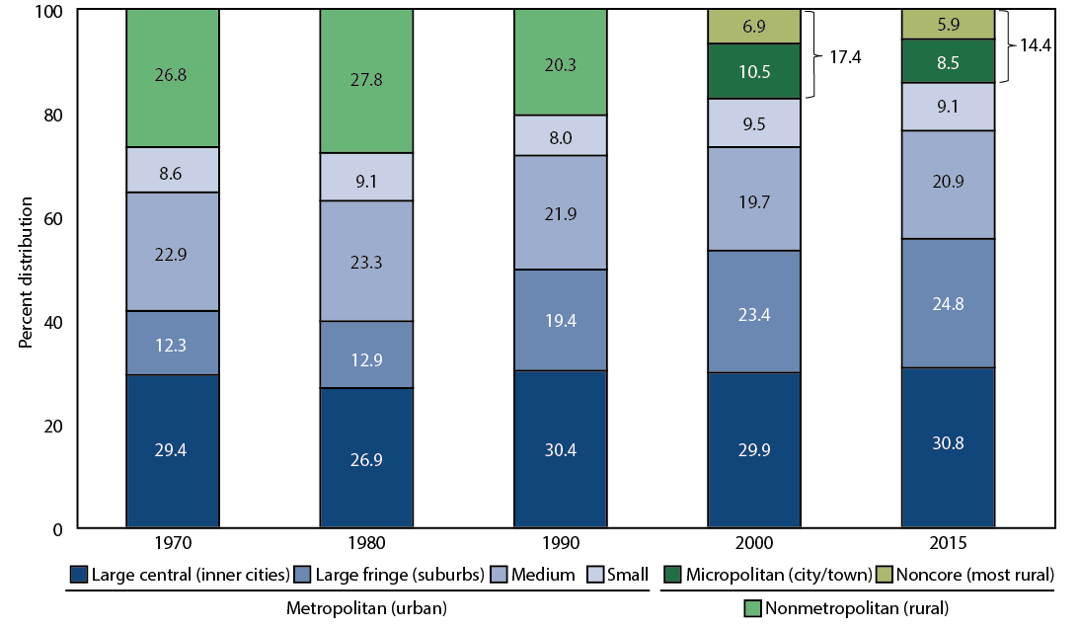
Population, by urbanization level
NOTE: The categories micropolitan and noncore were not used in 1970, 1980, and 1990; therefore, total nonmetropolitan population is shown.
SOURCE: NCHS, Health, United States, 2016, Figure 5. Data from the U.S. Census Bureau; 1970 and 1980 from Department of Agriculture Economic Research Service reports.

Slide 7
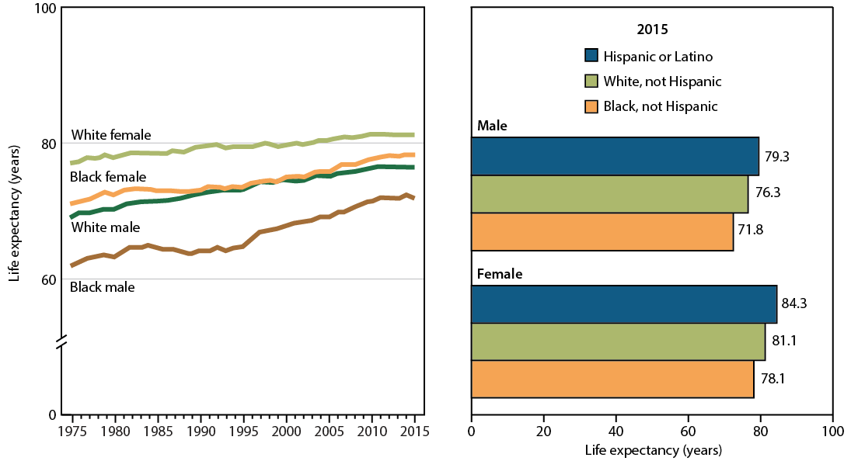
Life expectancy at birth
NOTE: Life expectancy data by Hispanic origin were available starting in 2006 and were corrected to address racial and ethnic misclassification.
SOURCE: NCHS, Health, United States, 2016, Figure 6. Data from the National Vital Statistics System (NVSS).

Slide 8
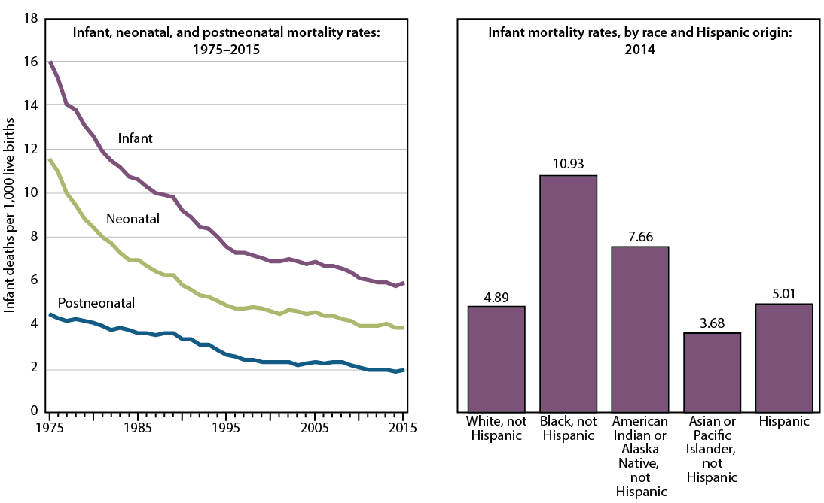
Infant mortality rates
SOURCE: NCHS, Health, United States, 2016, Figure 7. Data from the National Vital Statistics System (NVSS).

Slide 9
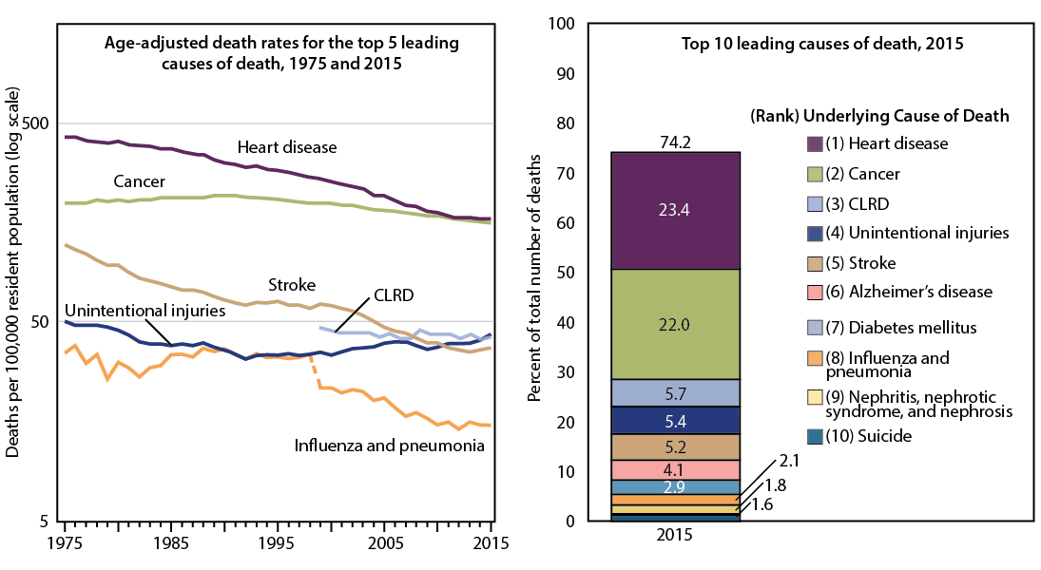
Leading causes of death
NOTE: Due to coding changes for chronic lower respiratory diseases (CLRD) between ICD–9 and ICD–10, which prevent the direct comparison of trends prior to 1998 and after 1999, rates for CLRD are only shown for 1999 onwards.
SOURCE: NCHS, Health, United States, 2016, Figure 8. Data from the National Vital Statistics System (NVSS).

Slide 10
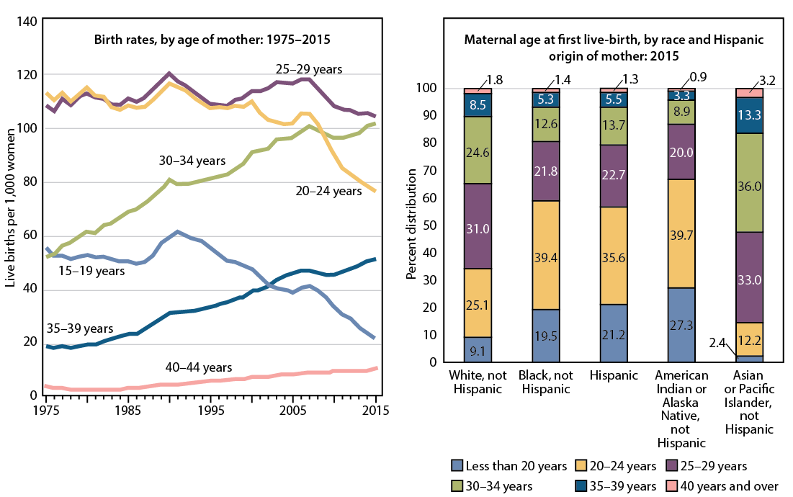
Birth rates
SOURCE: NCHS, Health, United States, 2016, Figure 9. Data from the National Vital Statistics System (NVSS).

Slide 11
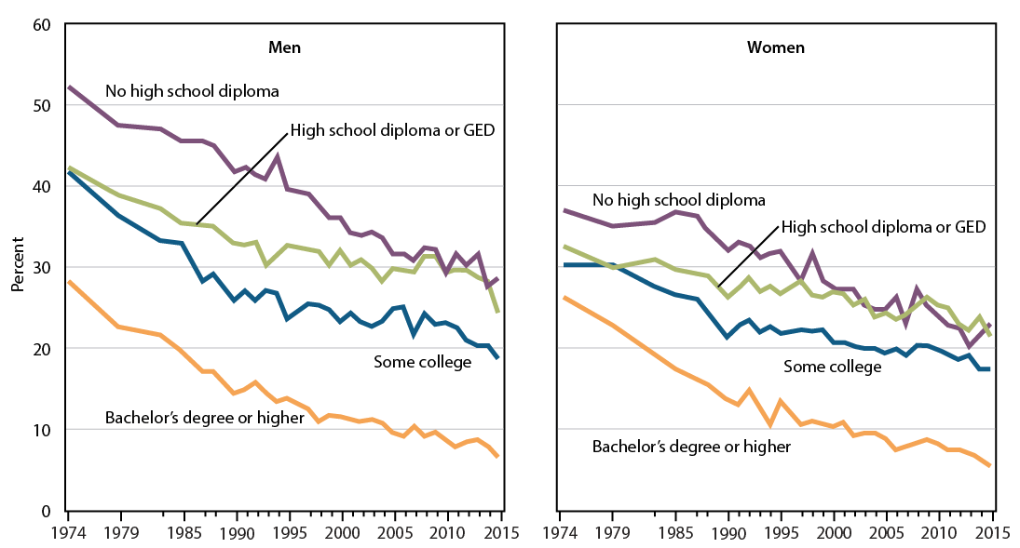
Current cigarette smoking: Adults aged 25+
NOTE: Smoked 100 cigarettes in their lifetime and now smoke every day or some days.
SOURCE: NCHS, Health, United States, 2016, Figure 10 and Table 48. Data from the National Health Interview Survey (NHIS).

Slide 12
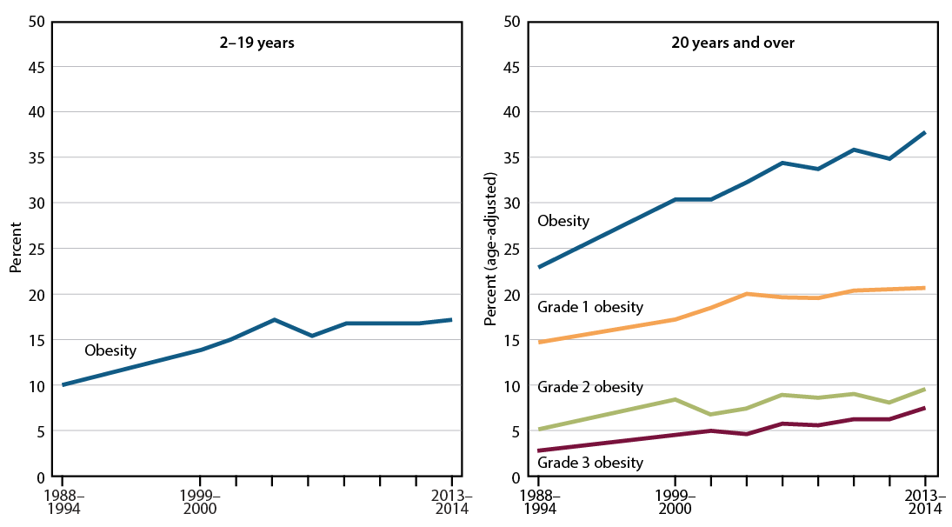
Obesity
NOTES: For children and adolescents aged 2–19, obesity is defined as a body mass index (BMI) at or above the sex- and age-specific 95th percentile of the CDC growth charts. For adults, obesity is defined as a BMI at or above 30, Grade 1 obesity is a BMI from 30.0 to 34.9, Grade 2 obesity is a BMI from 35.0 to 39.9, and Grade 3 obesity is a BMI greater than or equal to 40.0. Estimates for adults are age-adjusted.
SOURCE: NCHS, Health, United States, 2016, Figure 11. Data from the National Health and Nutrition Examination Survey (NHANES).

Slide 13
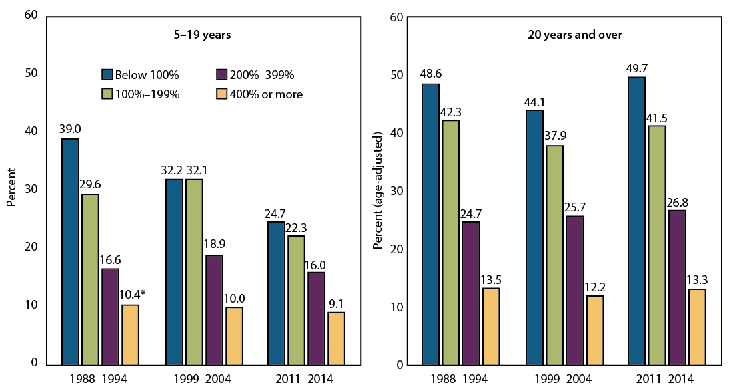
Untreated dental caries
NOTES: Estimates for adults are age-adjusted. Untreated dental caries refers to decay on the crown or enamel surface of a tooth that has not been treated or filled.
SOURCE: NCHS, Health, United States, 2016, Figure 12. Data from the National Health and Nutrition Examination Survey (NHANES).

Slide 14
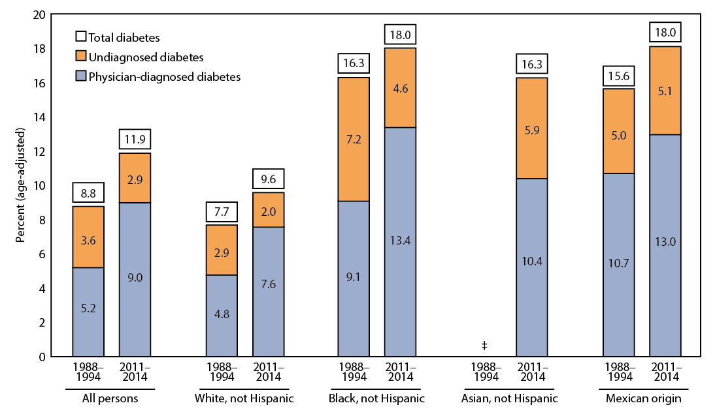
Diabetes among adults
NOTES: Estimates are age-adjusted. Estimates are not available for non-Hispanic Asian persons in 1988–1994.
SOURCE: NCHS, Health, United States, 2016, Figure 13. Data from the National Health and Nutrition Examination Survey (NHANES).

Slide 15
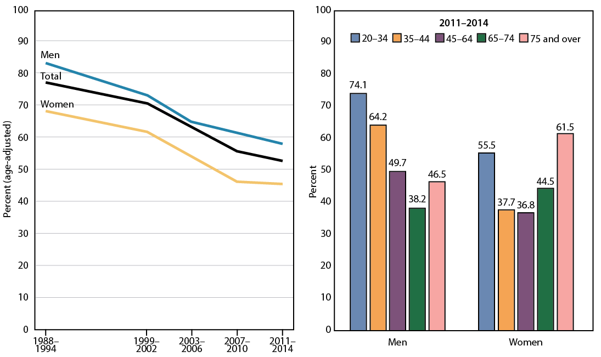
Uncontrolled high blood pressure among adults with hypertension
NOTES: Uncontrolled high blood pressure is a measured systolic blood pressure of at least 140 mm Hg or a measured diastolic blood pressure of at least 90 mm Hg, among those with measured high blood pressure or who reported taking antihypertensive medication. Estimates for left panel are age-adjusted.
SOURCE: NCHS, Health, United States, 2016, Figure 14. Data from the National Health and Nutrition Examination Survey (NHANES).

Slide 16
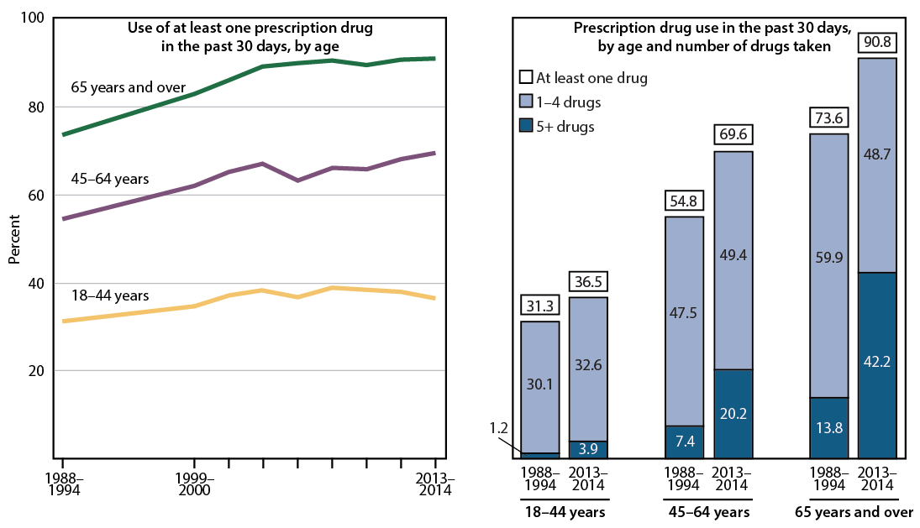
Prescription drug use
NOTE: Respondent-reported use of prescription drugs in the past 30 days.
SOURCE: NCHS, Health, United States, 2016, Figure 15. Data from the National Health and Nutrition Examination Survey (NHANES).

Slide 17
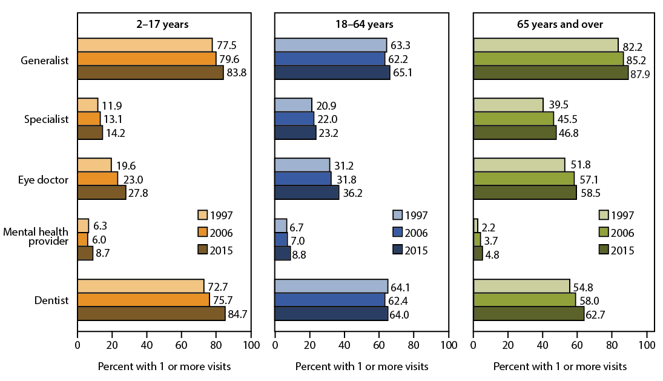
Health care visits
SOURCE: NCHS, Health, United States, 2016, Figure 16. Data from the National Health Interview Survey (NHIS).

Slide 18
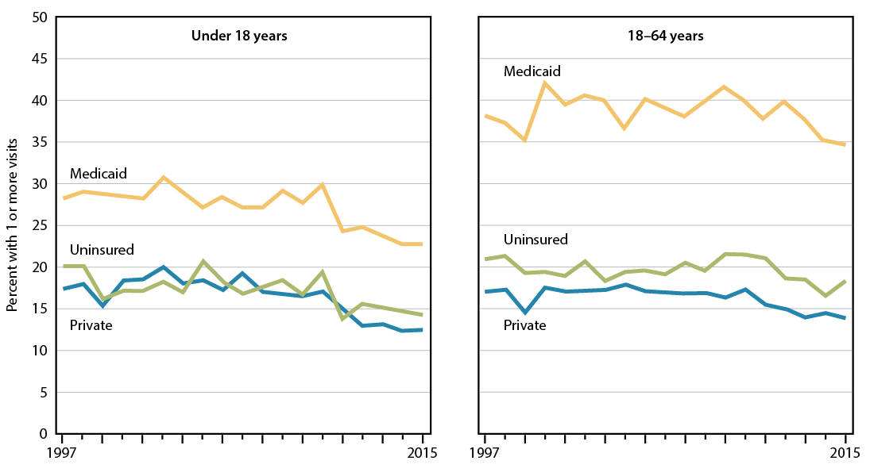
Emergency department visits
SOURCE: NCHS, Health, United States, 2016, Figure 17. Data from the National Health Interview Survey (NHIS).

Slide 19
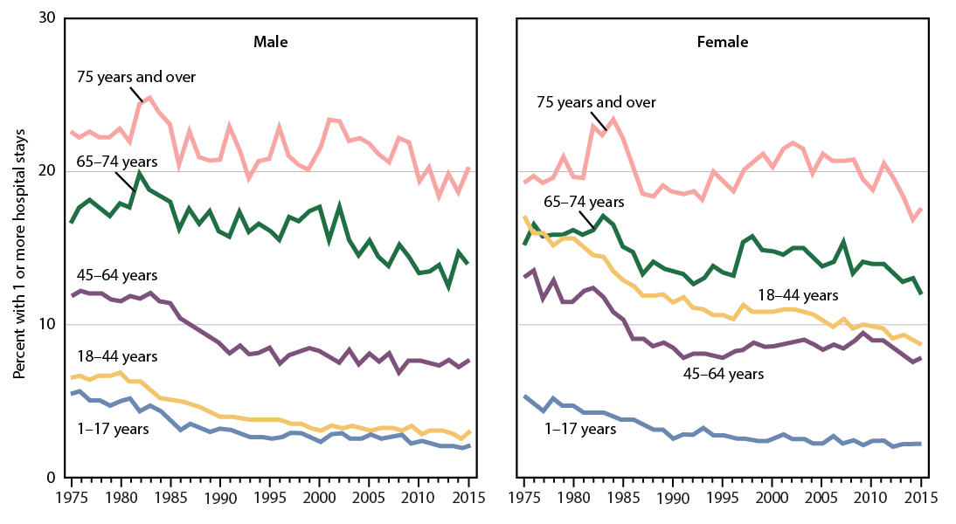
Overnight hospital stays
NOTE: Hospitalizations include those relating to deliveries.
SOURCE: NCHS, Health, United States, 2016, Figure 18. Data from the National Health Interview Survey (NHIS).

Slide 20
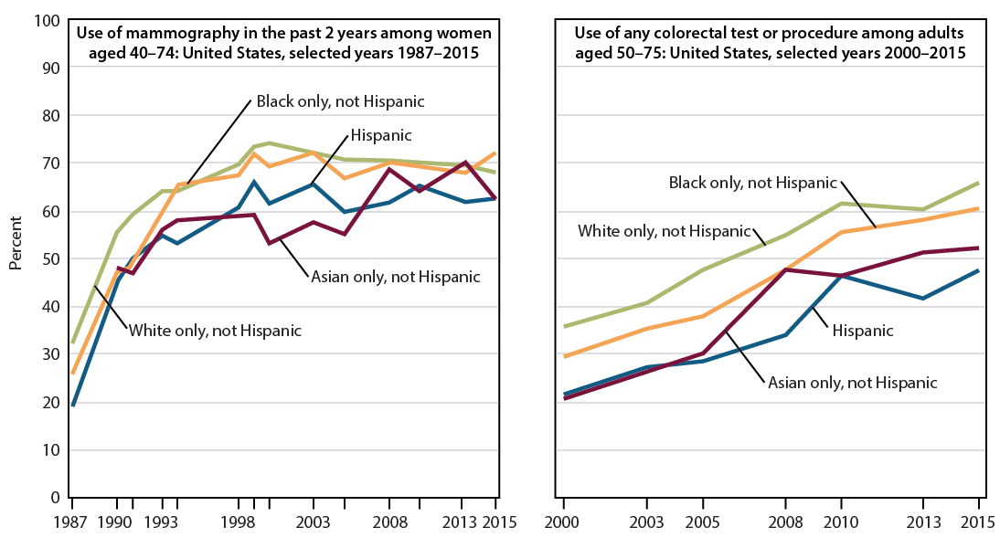
Mammography use and colorectal cancer testing use
NOTES: Mammograms and colorectal cancer testing and procedures may be used for diagnostic or screening purposes. It is not possible to determine the purpose of the test in NHIS.
SOURCE: NCHS, Health, United States, 2016, Figure 19. Data from the National Health Interview Survey (NHIS).

Slide 21
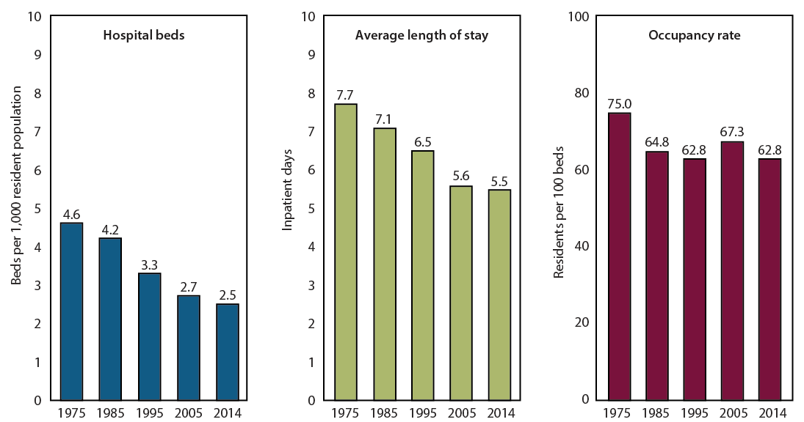
Community Hospitals
SOURCE: NCHS, Health, United States, 2016, Figure 20. Data from the American Hospital Association (AHA).

Slide 22
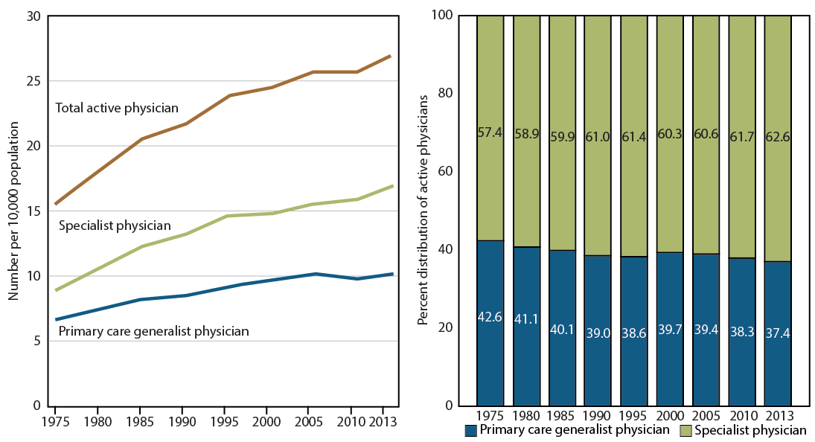
Active primary care generalists and specialist physicians
NOTES: Primary care generalist physicians include family medicine, internal medicine, obstetrics and gynecology, and pediatrics. Specialists include all other specialties and primary care subspecialists.
SOURCE: NCHS, Health, United States, 2016, Figure 21. Data from the American Medical Association (AMA).

Slide 23
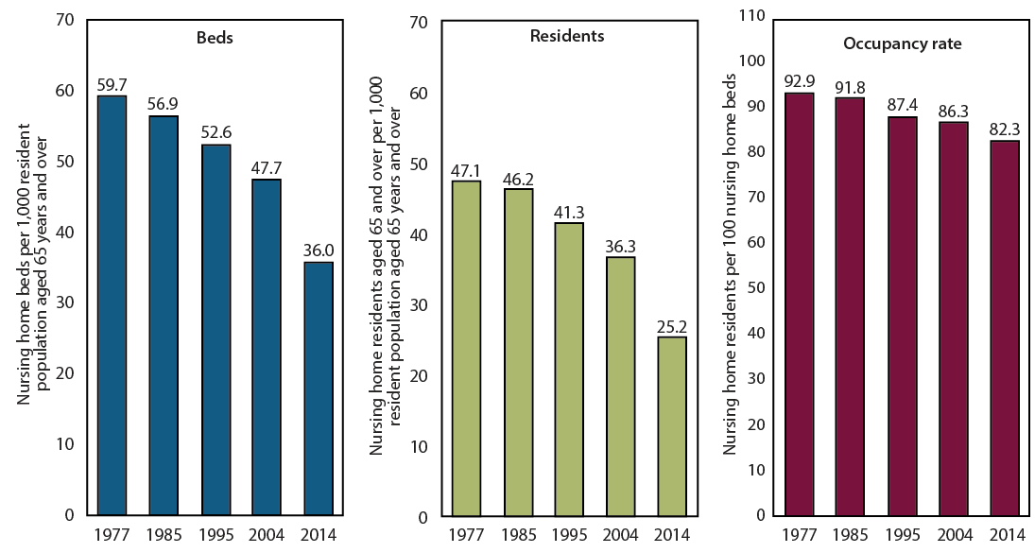
Nursing homes
SOURCE: NCHS, Health, United States, 2016, Figure 22. Data from the National Nursing Home Survey (NNHS) for 1977, 1985, 1995, and 2004 data and the National Study of Long-Term Care Providers (NSLTCP) for 2014 data.

Slide 24
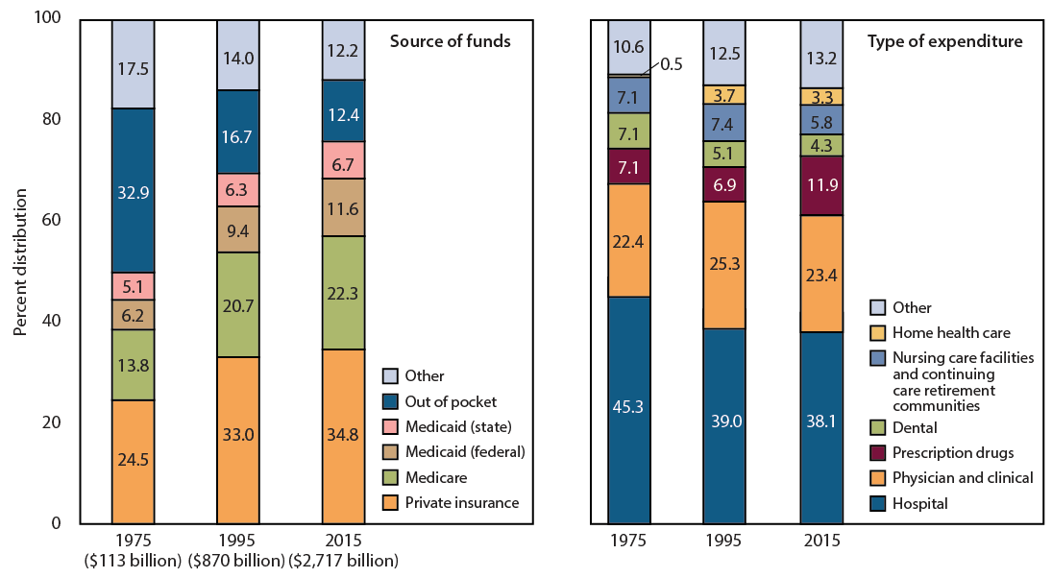
Personal health care expenditures
NOTE: Personal health care expenditures are outlays for goods and services relating directly to patient care.
SOURCE: NCHS, Health, United States, 2016, Figure 23. Data from the Centers for Medicare & Medicaid Services, National Health Expenditures Accounts (NHEA).

Slide 25
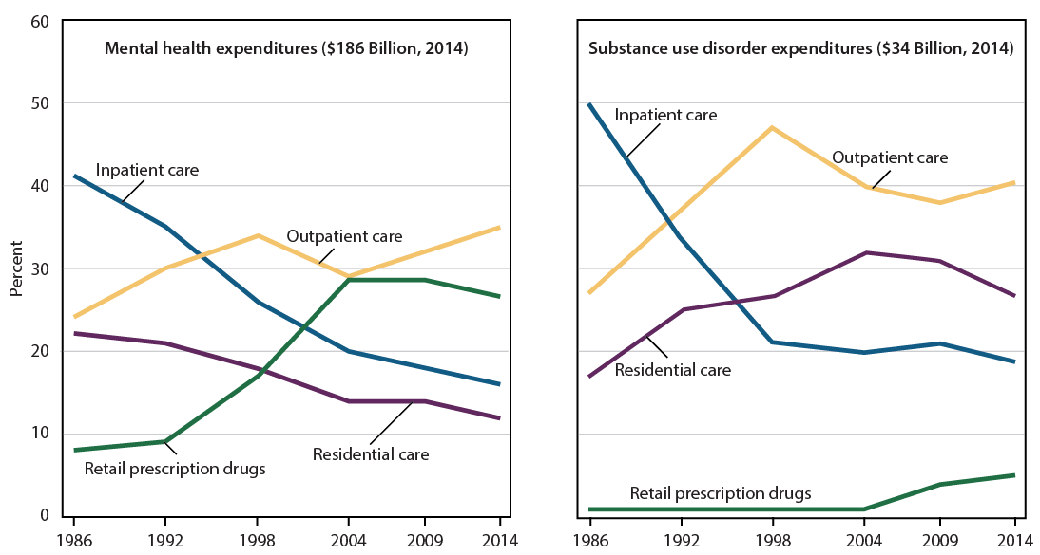
Mental health and substance use disorder expenditures
SOURCE: NCHS, Health, United States, 2016, Figure 24. Data from the Substance Abuse and Mental Health Services Administration (SAMHSA), Behavioral Health Spending and Use Accounts (BHSUA).

Slide 26
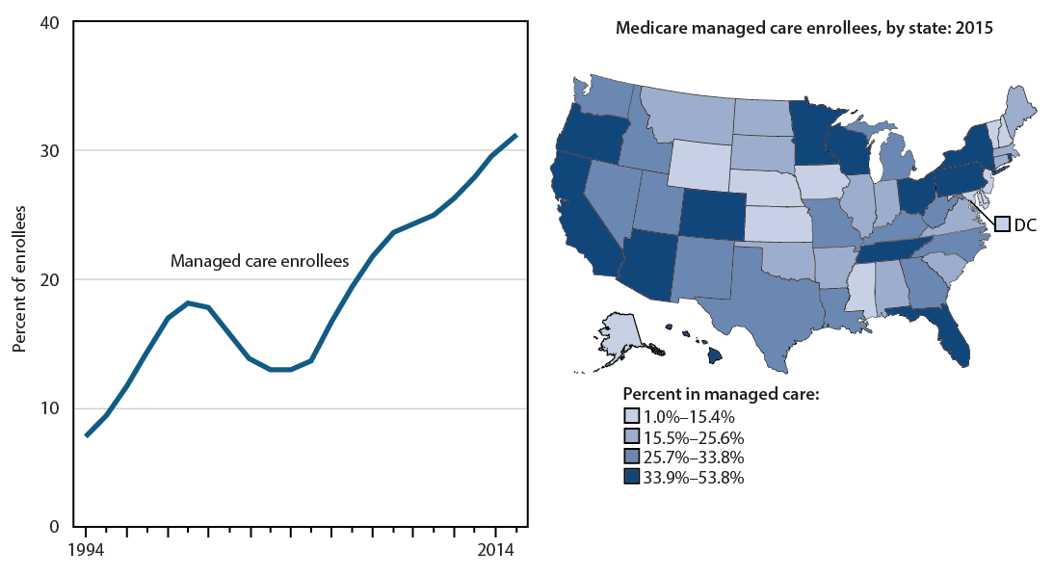
Medicare enrollees in managed care
SOURCE: NCHS, Health, United States, 2016, Figure 25. Data from the Centers for Medicare & Medicaid Services, Medicare Administrative Data.

Slide 27
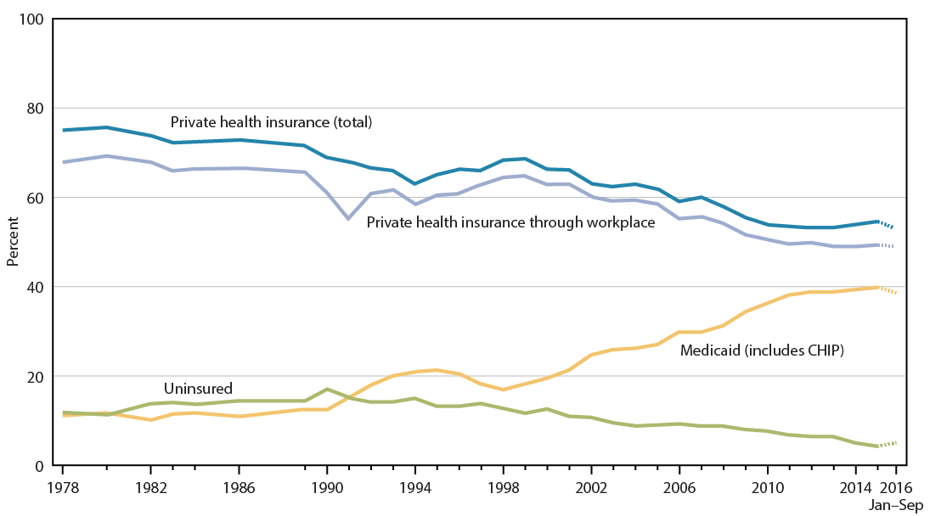
Health insurance coverage: Children under age 18
NOTES: Preliminary estimates for the first 9 months of 2016 are shown with a dashed line. Health insurance coverage, definitions, and questionnaires have changed over time.
SOURCE: NCHS, Health, United States, 2016, Figure 26. Data from the National Health Interview Survey (NHIS).

Slide 28
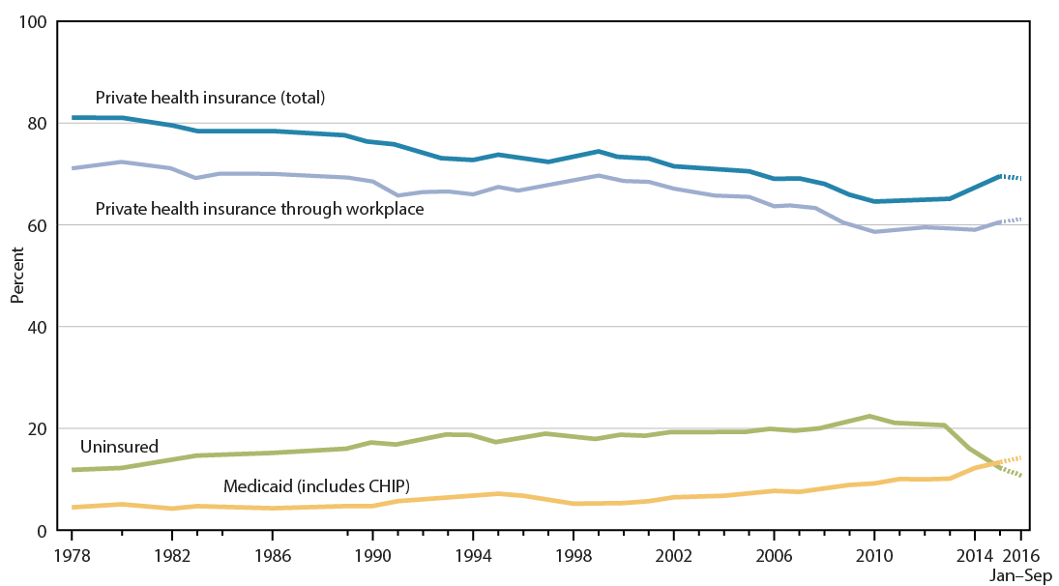
Health insurance coverage: Adults aged 18–64
NOTES: Preliminary estimates for the first 9 months of 2016 are shown with a dashed line. Health insurance coverage, definitions, and questionnaires have changed over time.
SOURCE: NCHS, Health, United States, 2016, Figure 27. Data from the National Health Interview Survey (NHIS).

Slide 29
