Slide 1
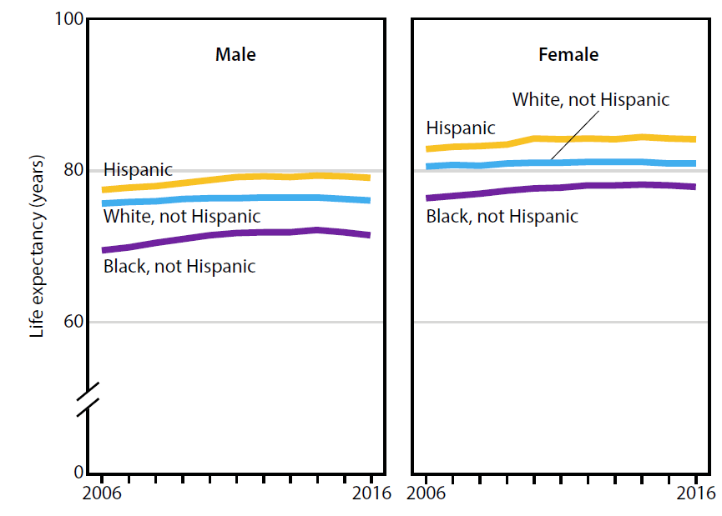
Life expectancy at birth, by sex and race
and Hispanic origin
NOTES: Life expectancy data by Hispanic origin were available starting in 2006 and were corrected to address racial and ethnic misclassification. Life expectancy estimates for 2016 are based on preliminary Medicare data.
SOURCE: NCHS, Health, United States, 2017, Figure 1. Data from the National Vital Statistics System (NVSS), Mortality.

Slide 2
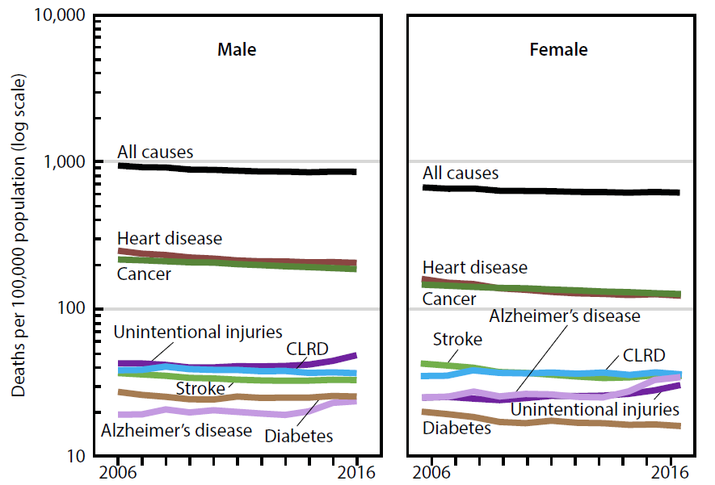
Age-adjusted death rates for selected
causes of death, by sex
NOTES: Stroke is cerebrovascular disease. CLRD is chronic lower respiratory diseases.
SOURCE: NCHS, Health, United States, 2017, Figure 2. Data from the National Vital Statistics System (NVSS), Mortality.

Slide 3
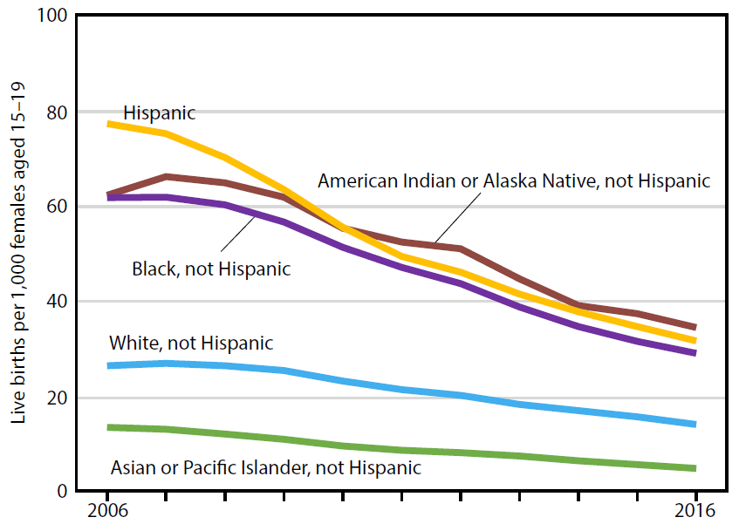
Teen childbearing,
by race and Hispanic origin
NOTE: Estimates are based on single-race categories; multiple-race data were bridged to single-race categories as needed.
SOURCE: NCHS, Health, United States, 2017, Figure 3. Data from the National Vital Statistics System (NVSS), Natality.

Slide 4
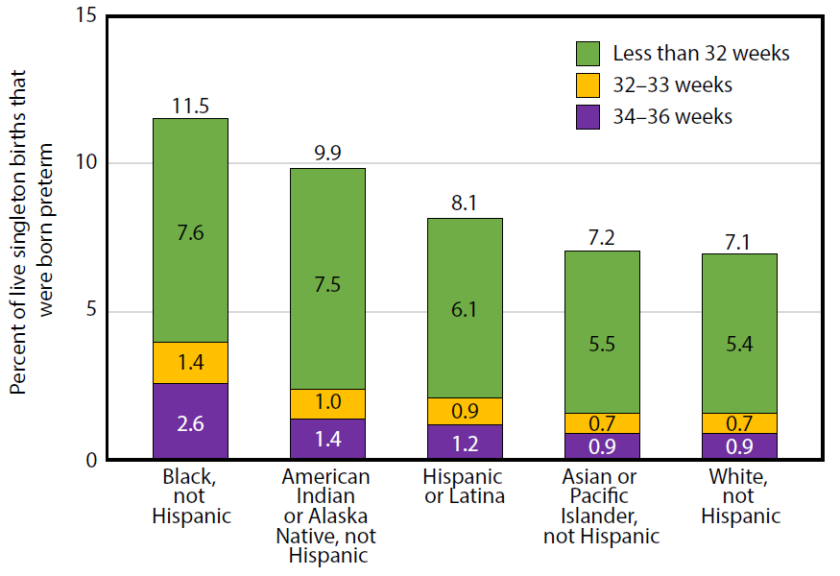
Preterm singleton births, by gestational age and
race and Hispanic origin of mother
NOTES: Preterm births are based on the obstetric estimate of gestational age and are for all singleton births. Singleton births refer to single births, in contrast with multiple or higher order births. Estimates may not sum to total percentage due to rounding.
SOURCE: NCHS, Health, United States, 2017, Figure 4. Data from the National Vital Statistics System (NVSS), Natality.

Slide 5
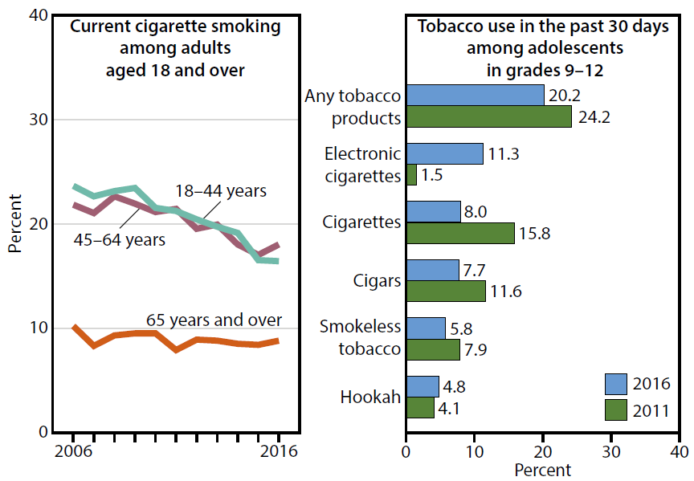
Cigarette smoking among adults and
tobacco use among adolescents
NOTES: Current cigarette smoking by adults is defined as having smoked 100 or more cigarettes in their lifetime and smoking now, every day or some days. Use of tobacco products by students in grades 9–12 is defined as having used the product on one or more days during the past 30 days. Data on bidis and pipe tobacco can be found in the data table.
SOURCE: NCHS, Health, United States, 2017, Figure 5. Data from the National Health Interview Survey (NHIS) and CDC, National Youth Tobacco Survey (NYTS).

Slide 6
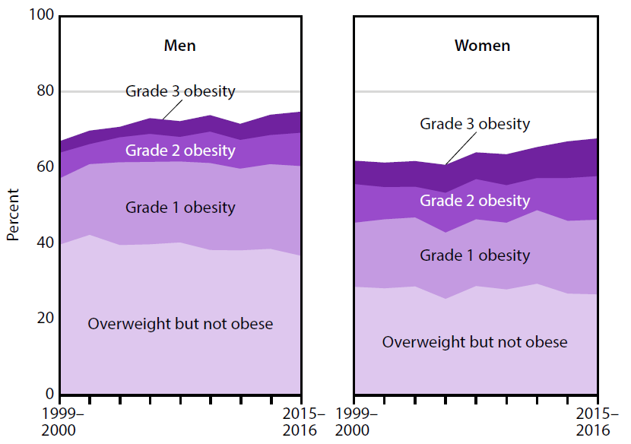
Overweight and obesity
among adults
NOTES: Estimates are age-adjusted. BMI is body mass index. Overweight but not obese is defined as a BMI at or above 25.0 to 29.9. Grade 1 obesity is a BMI at or above 30.0 to 34.9, Grade 2 obesity is a BMI from 35.0 to 39.9, and Grade 3 obesity is a BMI greater than or equal to 40.0.
SOURCE: NCHS, Health, United States, 2017, Figure 6. Data from the National Health and Nutrition Examination Survey (NHANES).

Slide 7
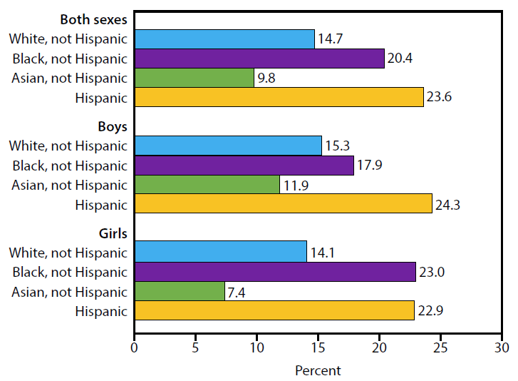
Obesity among children
and adolescents
NOTE: Obesity in youth is defined as body mass index (BMI) at or above the sex- and age-specific 95th percentile of the 2000 CDC Growth Charts.
SOURCE: NCHS, Health, United States, 2017, Figure 7. Data from the National Health and Nutrition Examination Survey (NHANES).

Slide 8
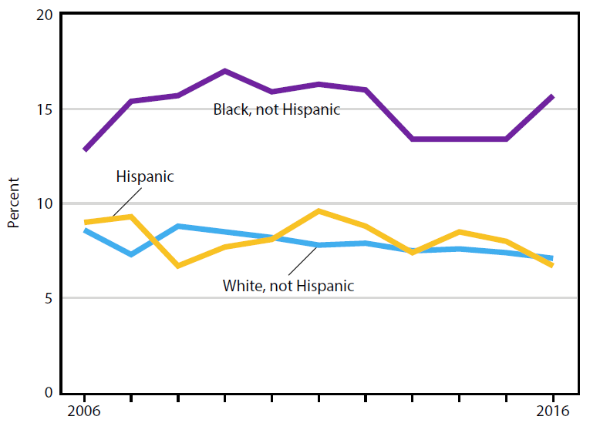
Current asthma
among children
SOURCE: NCHS, Health, United States, 2017, Figure 8. Data from the National Health Interview Survey (NHIS).

Slide 9
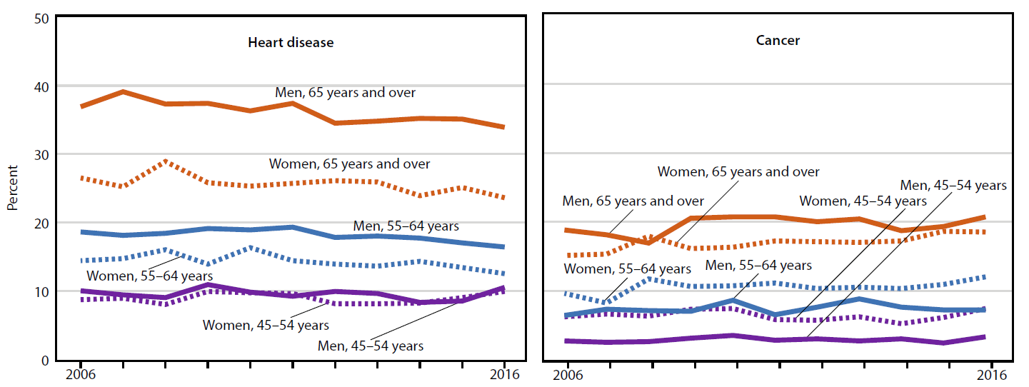
Heart disease and cancer
NOTES: Heart disease is based on self-reported responses to questions about whether respondents had ever been told by a doctor or other health professional that they had coronary heart disease, angina (angina pectoris), a heart attack (myocardial infarction), or any other kind of heart disease or heart condition. Cancer is based on self-reported responses to a question about whether respondents had ever been told by a doctor or other health professional that they had cancer or a malignancy of any kind. Excludes squamous cell and basal cell carcinoma.
SOURCE: NCHS, Health, United States, 2017, Figure 9. Data from the National Health Interview Survey (NHIS).

Slide 10
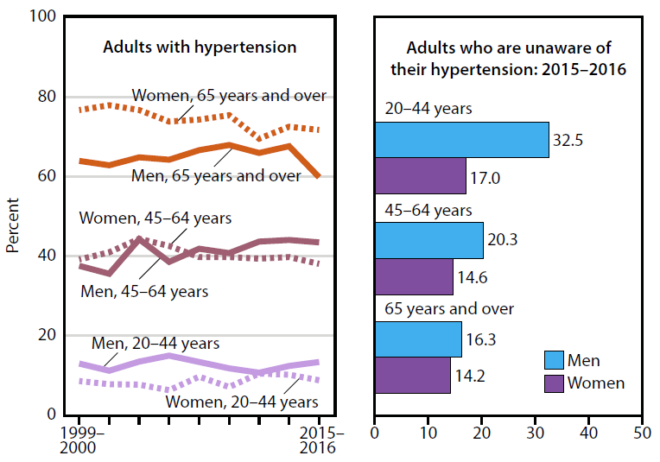
Hypertension and
awareness of hypertension
SOURCE: NCHS, Health, United States, 2017, Figure 10. Data from the National Health and Nutrition Examination Survey (NHANES).

Slide 11
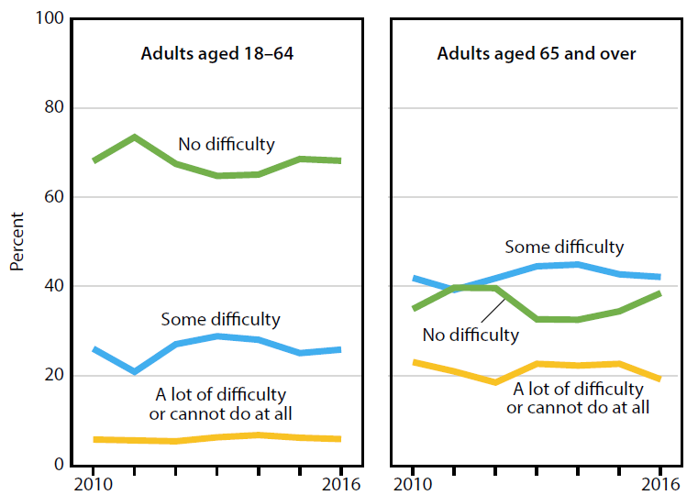
Functional limitation
NOTES: Functional limitation is defined by the reported level of difficulty in six domains of functioning: seeing (even if wearing glasses), hearing (even if wearing hearing aids), mobility (walking or climbing stairs), communication (understanding or being understood by others), cognition (remembering or concentrating), and self-care (such as washing all over or dressing). Estimates are age-adjusted.
SOURCE: NCHS, Health, United States, 2017, Figure 11. Data from the National Health Interview Survey (NHIS).

Slide 12
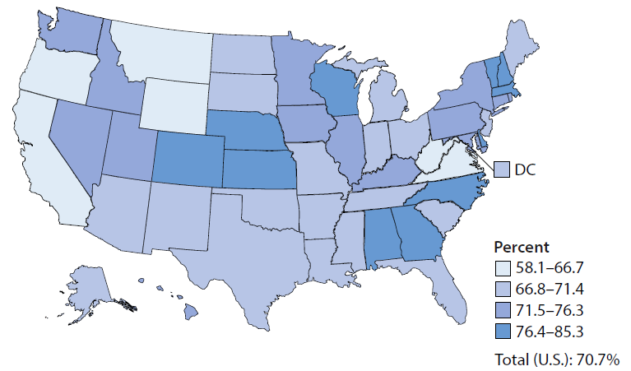
Vaccination coverage for combined 7-vaccine series
NOTES: Data for the map are displayed by a modified Jenks classification for the 50 U.S. states and D.C., which creates categories that minimize within-group variation and maximize between-group variation.
SOURCE: NCHS, Health, United States, 2017, Figure 12. Data from the National Center for Immunization and Respiratory Diseases (NCIRD) and National Immunization Survey-Child (NIS-Child).

Slide 13
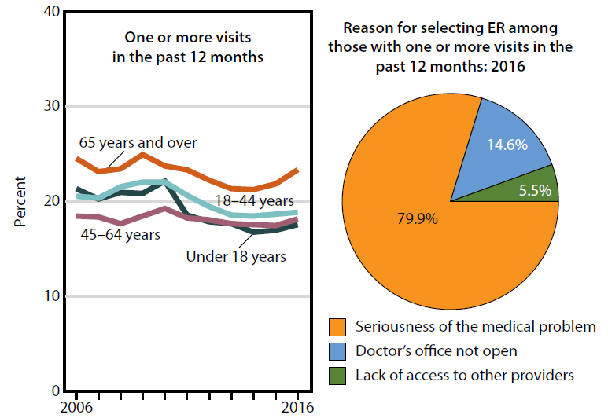
Emergency department visits and
reason for selecting emergency room
NOTES: Reason for choosing the ER was determined based on responses to a series of questions, used to define each category shown in the figure: seriousness of medical problem, doctor’s office not open, and lack of access to other providers.
SOURCE: NCHS, Health, United States, 2017, Figure 13. Data from the National Health Interview Survey (NHIS).

Slide 14
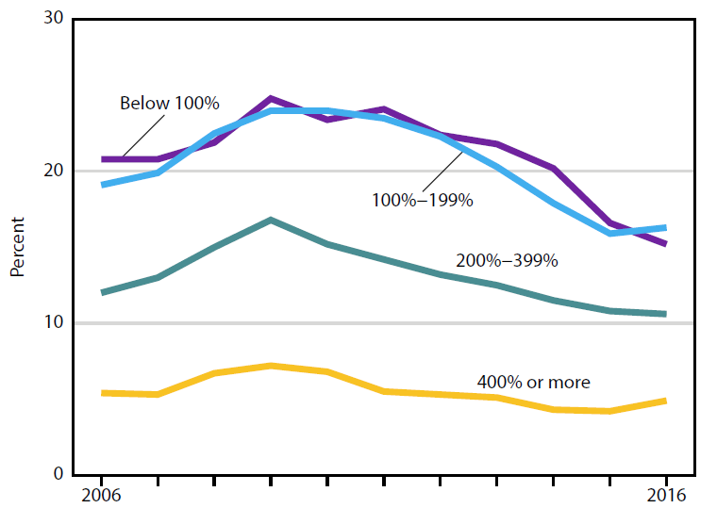
Delay or nonreceipt of needed medical care
SOURCE: NCHS, Health, United States, 2017, Figure 14 and Table 63. Data from the National Health Interview Survey (NHIS).

Slide 15
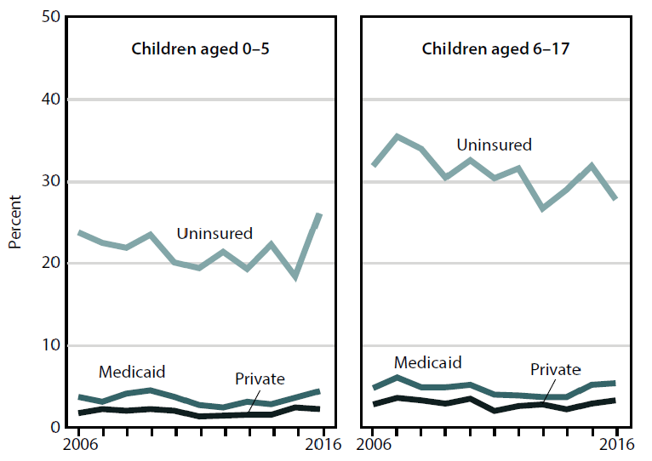
No usual source of care
NOTE: Health insurance categories are mutually exclusive and refer to status at the time of interview.
SOURCE: NCHS, Health, United States, 2017, Figure 15. Data from the National Health Interview Survey (NHIS).

Slide 16
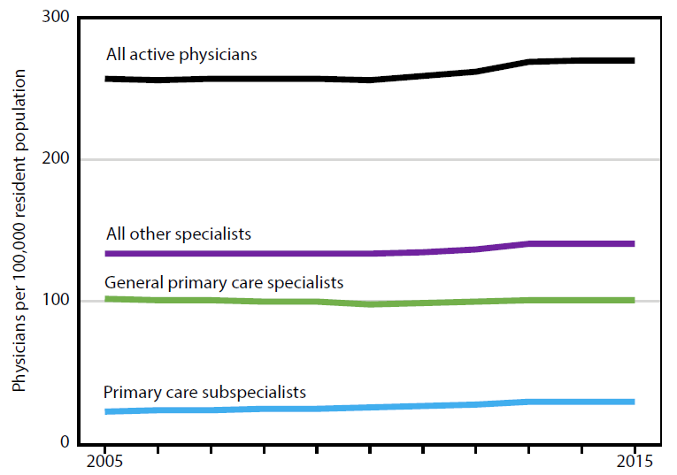
Physicians
NOTES: Specialty is self-designated. General primary care specialists were formerly referred to as generalists. The total U.S. resident population was used to calculate all rates.
SOURCE: NCHS, Health, United States, 2017, Figure 16. Data from the American Medical Association (AMA).

Slide 17
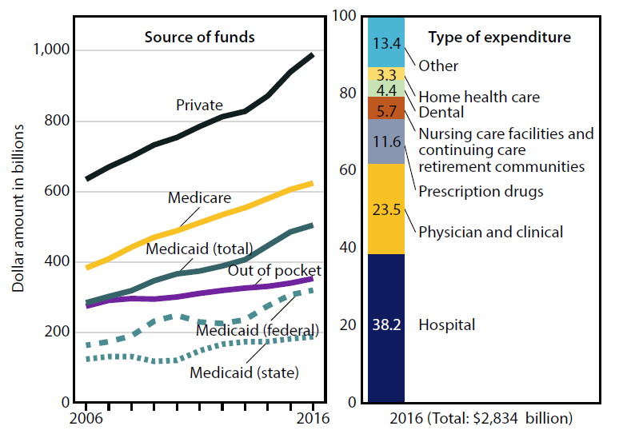
Personal health care expenditures
NOTES: Personal health care expenditures are outlays for goods and services relating directly to patient care. Personal health care expenditures are in current dollars and are not adjusted for inflation.
SOURCE: NCHS, Health, United States, 2017, Figure 17. Data from the Centers for Medicare & Medicaid Services, National Health Expenditures Accounts (NHEA).

Slide 18
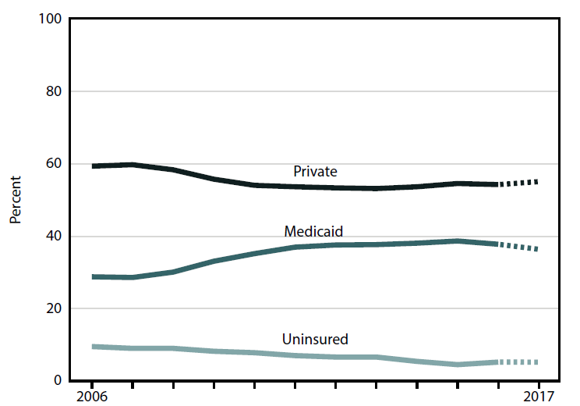
Health insurance coverage:
Children under age 18
NOTES: Estimates for 2017 are preliminary and are shown with a dashed line. Health insurance categories are mutually exclusive.
SOURCE: NCHS, Health, United States, 2017, Figure 18. Data from the National Health Interview Survey (NHIS).

Slide 19
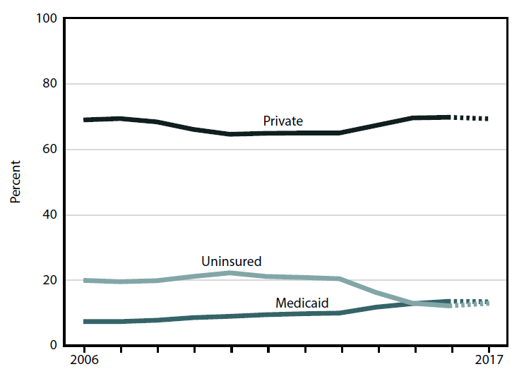
Health insurance coverage:
Adults aged 18–64
NOTES: Estimates for 2017 are preliminary and are shown with a dashed line. Health insurance categories are mutually exclusive.
SOURCE: NCHS, Health, United States, 2017, Figure 19. Data from the National Health Interview Survey (NHIS).

Slide 20
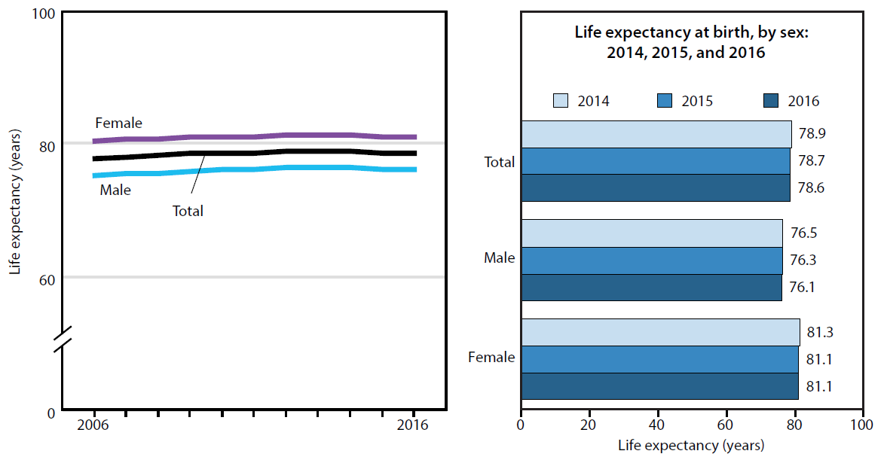
Life expectancy at birth, by sex
NOTE: Life expectancy estimates for 2016 are based on preliminary Medicare data.
SOURCE: NCHS, Health, United States, 2017, Figure 20. Data from the National Vital Statistics System (NVSS), Mortality.

Slide 21
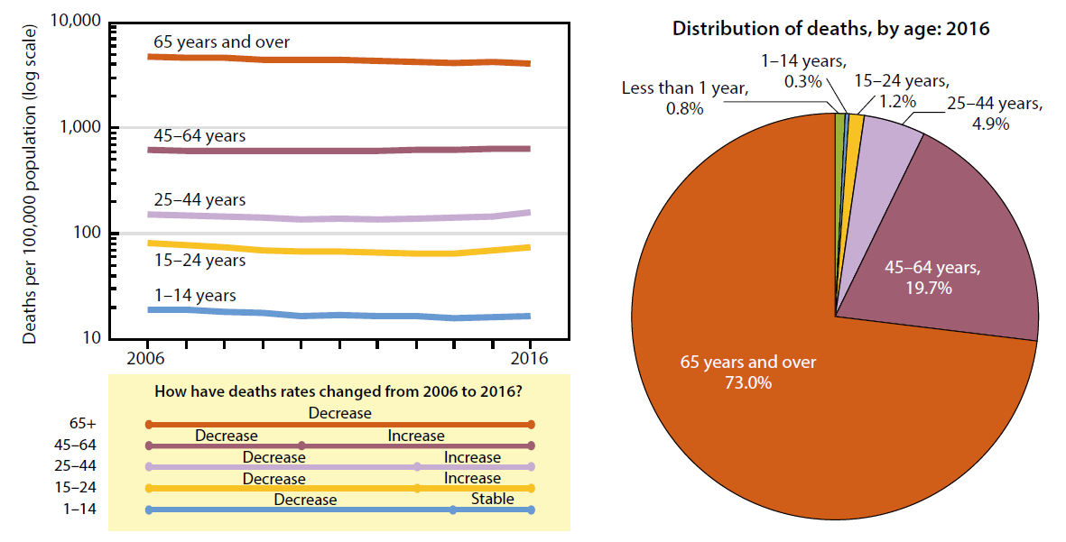
Death rates for all causes, by age
NOTES: Deaths of persons with age “Not Stated” are not included in the pie chart. Deaths of persons with age “Not Stated” accounted for less than 0.1% of all deaths.
SOURCE: NCHS, Health, United States, 2017, Figure 21. Data from the National Vital Statistics System (NVSS), Mortality.

Slide 22
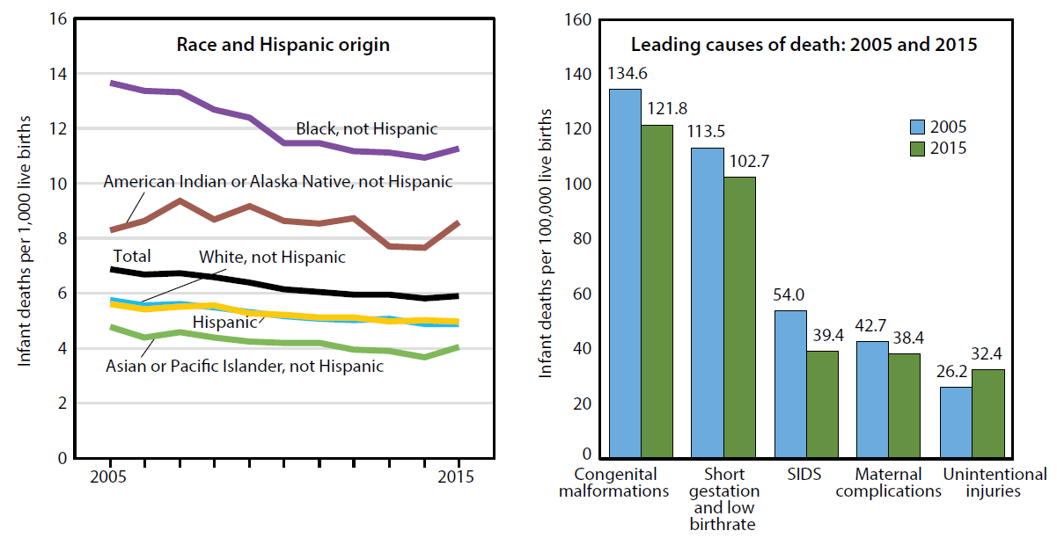
Infant mortality rates
NOTES: Congenital malformations is congenital malformations, deformations, and chromosomal abnormalities. SIDS is sudden infant death syndrome. Unintentional injuries is accidents.
SOURCE: NCHS, Health, United States, 2017, Figure 22. Data from the National Vital Statistics System (NVSS), Linked Birth/Infant Death Data Set.

Slide 23
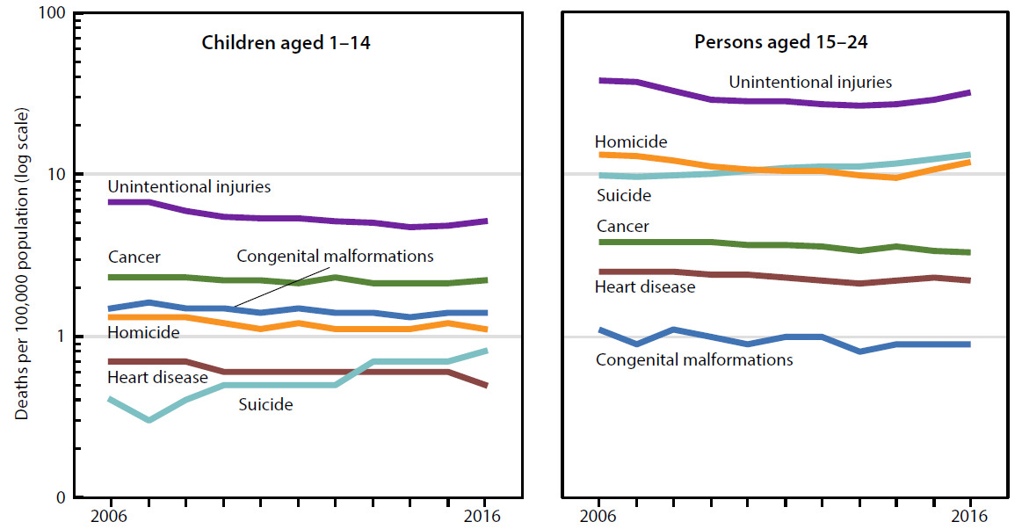
Leading causes of death: Children aged 1–14 years and
persons aged 15–24 years
NOTES: Unintentional injuries is accidents. Congenital malformations is congenital malformations, deformations, and chromosomal abnormalities. The majority of suicide deaths in children aged 1-14 years were among those aged 10–14 years.
SOURCE: NCHS, Health, United States, 2017, Figure 23. Data from the National Vital Statistics System (NVSS), Mortality.

Slide 24
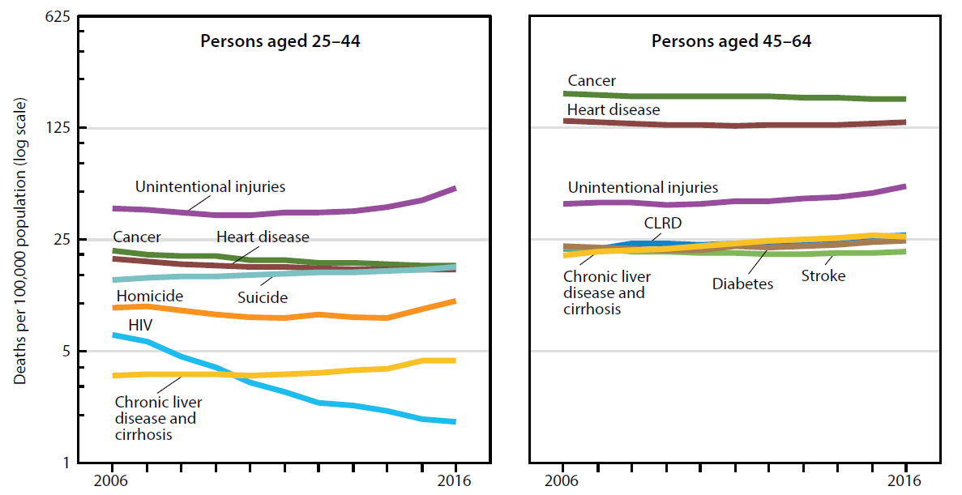
Leading causes of death:
Persons aged 25–44 and 45–64
NOTES: Unintentional injuries is accidents. HIV is human immunodeficiency virus. Stroke is cerebrovascular disease. CLRD is chronic lower respiratory disease.
SOURCE: NCHS, Health, United States, 2017, Figure 24. Data from the National Vital Statistics System (NVSS), Mortality.

Slide 25
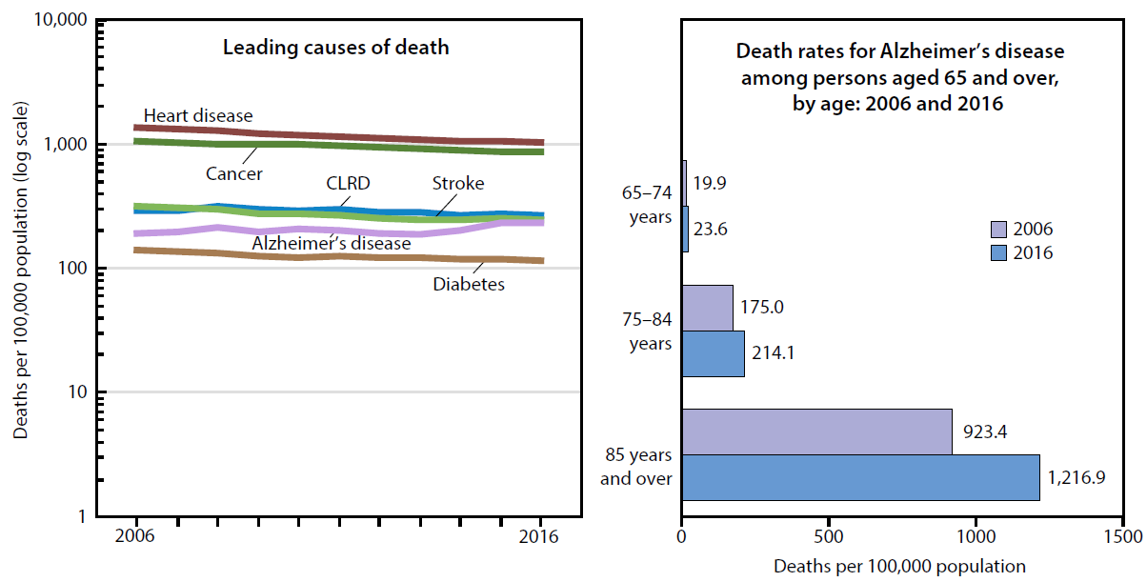
Leading causes of death and Alzheimer’s disease:
Persons aged 65 and over
NOTES: Stroke is cerebrovascular disease. CLRD is chronic lower respiratory disease.
SOURCE: NCHS, Health, United States, 2017, Figure 25. Data from the National Vital Statistics System (NVSS), Mortality.

Slide 26
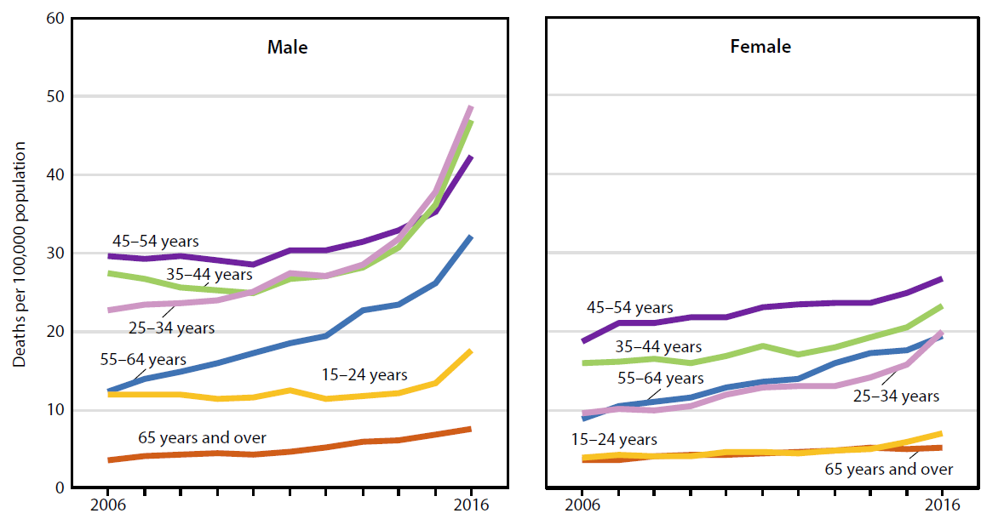
Drug overdose death rates by sex:
Persons aged 15 and over
NOTE: Drug overdose deaths are identified using International Classification of Diseases, 10th Revision (ICD–10) underlying cause of death codes X40–X44 (unintentional drug poisoning), X60–X64 (suicide by drug poisoning), X85 (homicide by drug poisoning) and Y10–Y14 (drug poisoning of undetermined intent).
SOURCE: NCHS, Health, United States, 2017, Figure 26. Data from the National Vital Statistics System (NVSS), Mortality.

Slide 27
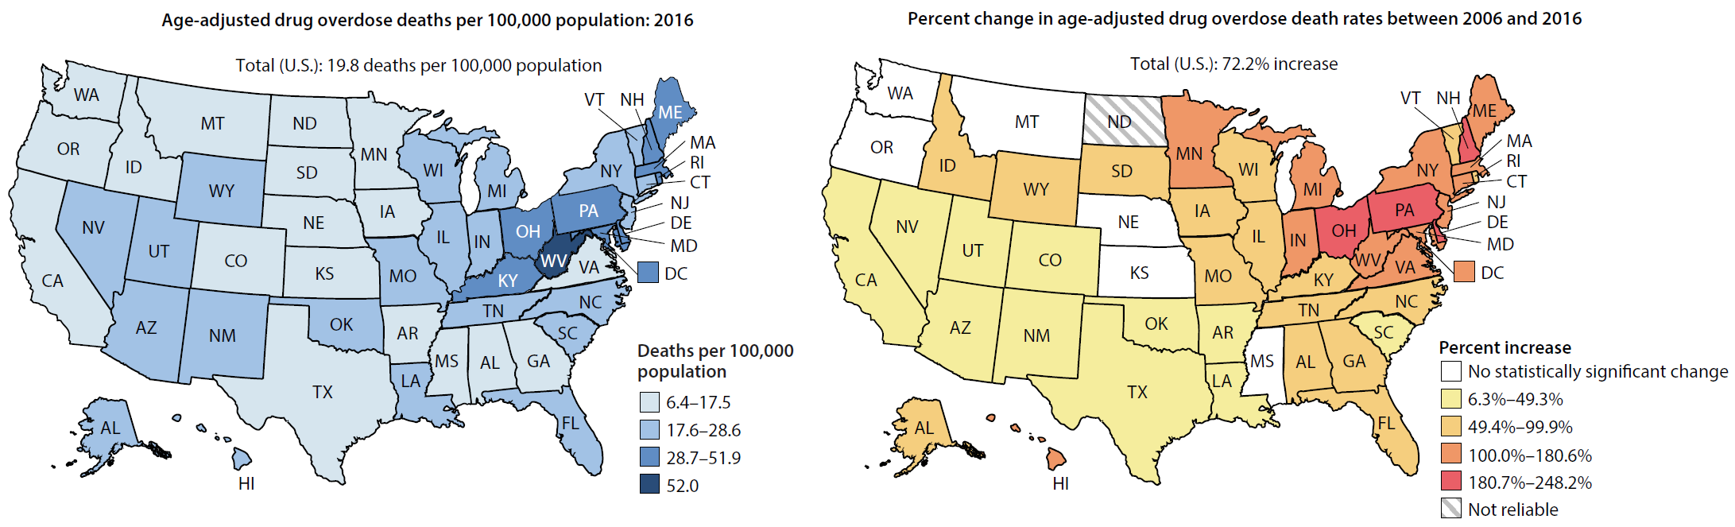
Age-adjusted drug overdose death rates by state:
All persons
NOTES: Drug overdose deaths are identified using International Classification of Diseases, 10th Revision (ICD–10) underlying cause of death codes X40–X44 (unintentional drug poisoning), X60–X64 (suicide by drug poisoning), X85 (homicide by drug poisoning) and Y10–Y14 (drug poisoning of undetermined intent). In 2006, the drug overdose death rate for North Dakota was unreliable, therefore, the percent change could not be calculated.
SOURCE: NCHS, Health, United States, 2017, Figure 27. Data from the National Vital Statistics System (NVSS), Mortality.

Slide 28
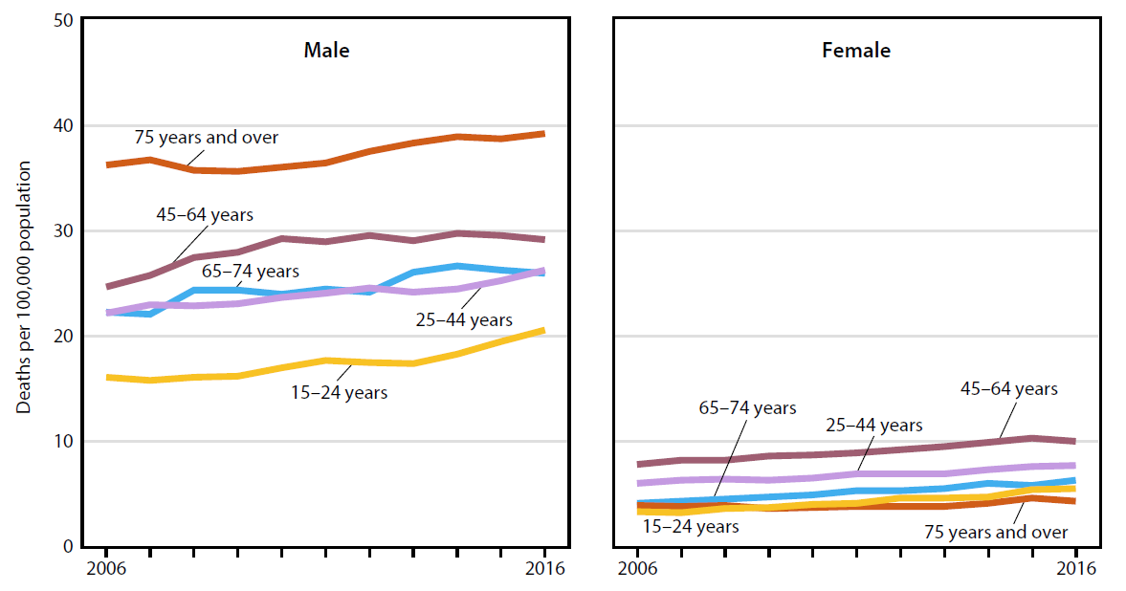
Suicide rates by sex:
Persons aged 15 and over
NOTE: Suicide deaths are identified using International Classification of Diseases, 10th Revision (ICD–10) underlying cause of death codes U03, X60–X84, and Y87.0.
SOURCE: NCHS, Health, United States, 2017, Figure 28. Data from the National Vital Statistics System (NVSS), Mortality.

Slide 29
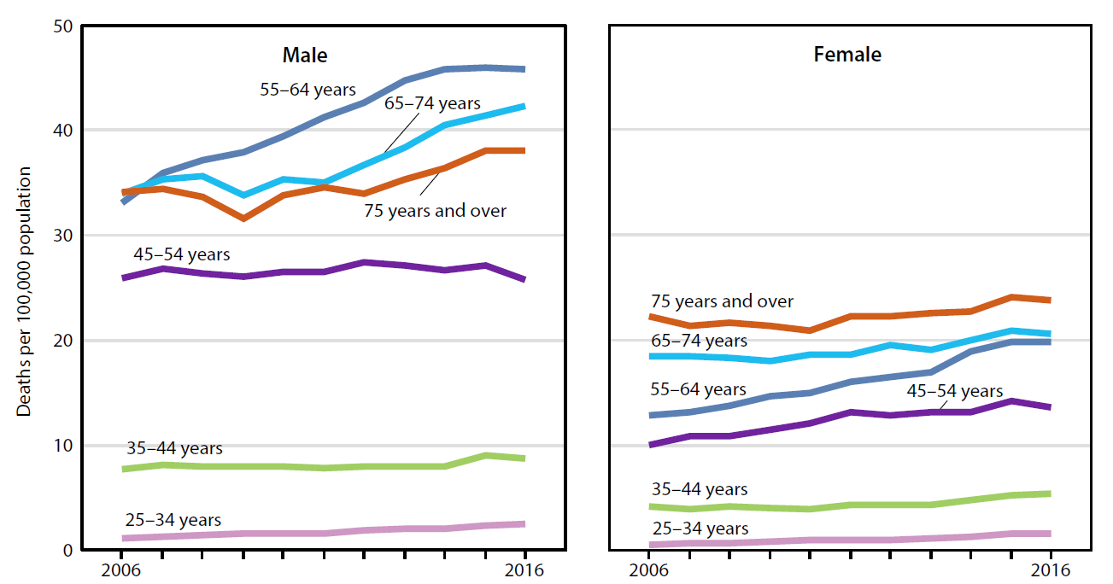
Chronic liver disease and cirrhosis death rates by sex:
Persons aged 25 and over
NOTES: Rates for 15–24 for most years are unreliable due to small size. Chronic liver disease and cirrhosis death rates are identified using International Classification of Diseases, 10th Revision (ICD–10) underlying cause of death codes K70, K73–K74.
SOURCE: NCHS, Health, United States, 2017, Figure 29. Data from the National Vital Statistics System (NVSS), Mortality.

Slide 30
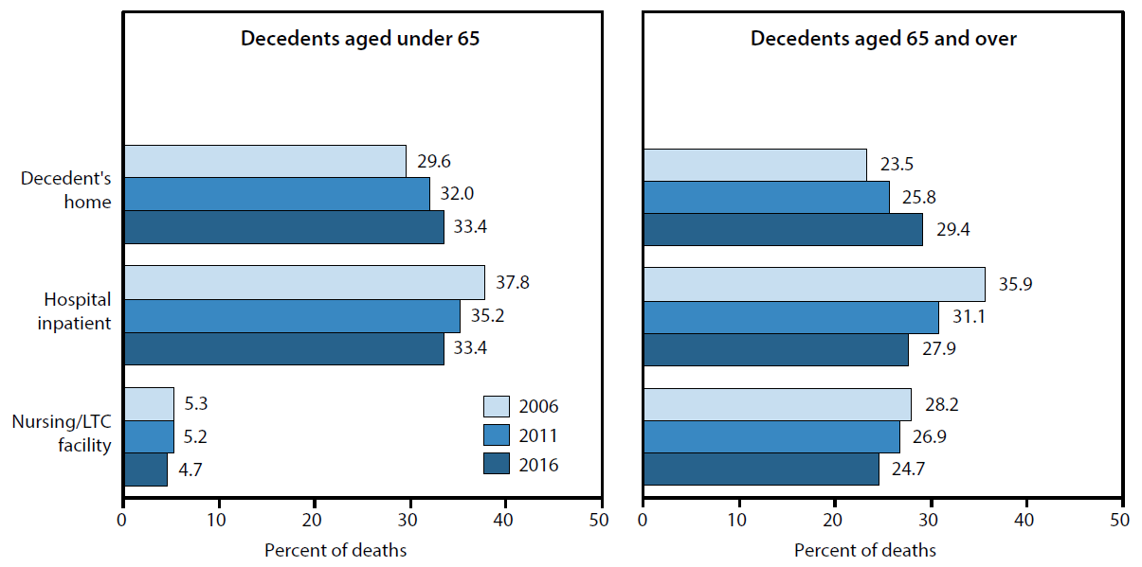
Place of death, by decedent’s age
NOTES: LTC is long-term care facility. Deaths in a licensed hospice facility and all other places of death are not included.
SOURCE: NCHS, Health, United States, 2017, Figure 30. Data from the National Vital Statistics System (NVSS), Mortality.

